Slide 1
Introduction to Data Analysis with R and Python Statistical Tools for Data Mining and Analytics
David Ryan
February 12, 2015

Slide 2
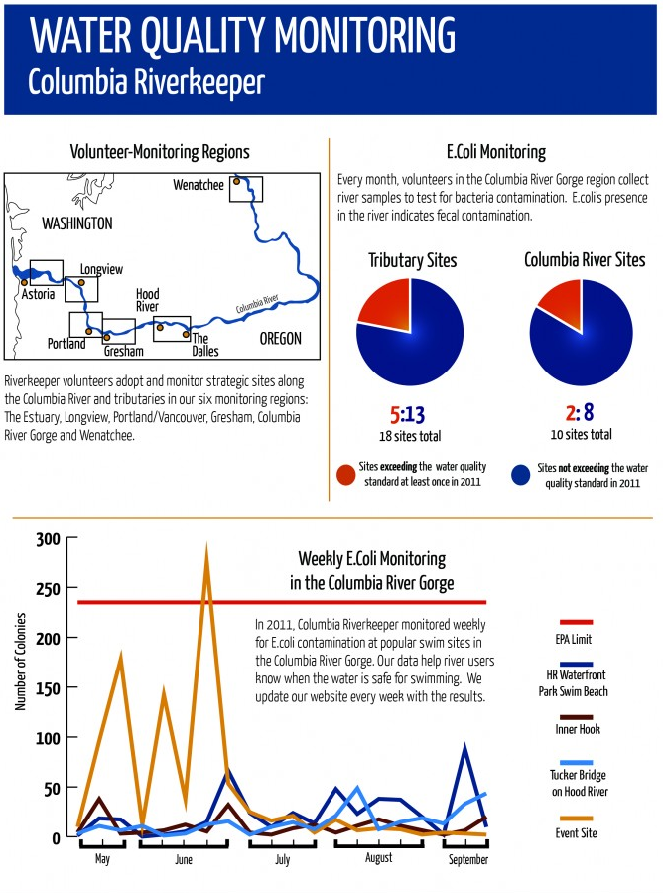
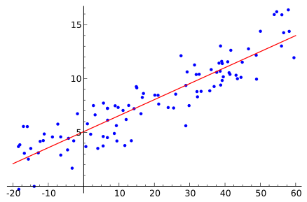
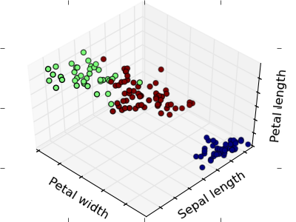
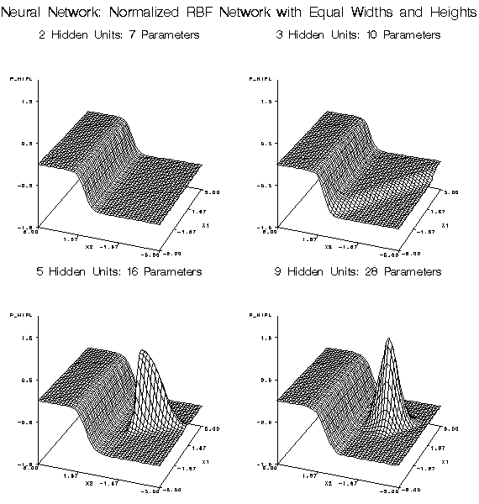
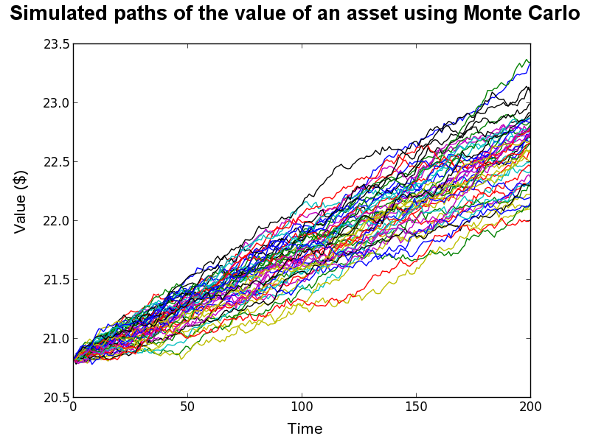
Data Analytics
DATA DESCRIPTION
Statistical Analysis
Reporting
 | Sepal Length | Sepal Width | Petal Length | Petal Width
Mean | 5.84 | 3.05 | 3.76 | 1.20
Standard Error | 0.07 | 0.04 | 0.14 | 0.06
Median | 5.80 | 3.00 | 4.35 | 1.30
Mode | 5.00 | 3.00 | 1.50 | 0.20
Standard Deviation | 0.83 | 0.43 | 1.76 | 0.76
Sample Variance | 0.69 | 0.19 | 3.11 | 0.58
Kurtosis | -0.55 | 0.29 | -1.40 | -1.34
Skewness | 0.31 | 0.33 | -0.27 | -0.10
Range | 3.60 | 2.40 | 5.90 | 2.40
Minimum | 4.30 | 2.00 | 1.00 | 0.10
Maximum | 7.90 | 4.40 | 6.90 | 2.50
Sum | 876.50 | 458.10 | 563.80 | 179.80
Count | 150.00 | 150.00 | 150.00 | 150.00
Predictive Modeling
Clustering
Simulation & Optimization
DATA MODELING
Notes:
Many data analytics people wonder, “am I doing analytics?”
Usually the answer is yes, but what kind?
There are many levels of analytics. Where are you now? Where do you want to be?
http://www.smhollingsworth.com/info/?p=430
http://scikit-learn.org/0.11/tutorial/statistical_inference/unsupervised_learning.html
http://en.wikipedia.org/wiki/Regression_analysis
http://support.sas.com/documentation/cdl/en/emxndg/64759/HTML/default/viewer.htm#p0x88tgo39zcyfn1qtikby80tn3a.htm
http://continuum.io/blog/monte-carlo-pricer (valuable resource for Monte Carlo simulation!!)

Slide 3

Top 10 (11) Data Mining Mistakes
Lack Proper Data
Focus on training
Rely on one technique
Ask the wrong question
Listen to (only) the data
Accept leaks from the future
Discount pesky cases
Extrapolate
Answer every inquiry
Sample casually
Believe the best model
Notes:
http://datamininglab.com/media/pdfs/TopTenMistakes.pdf
*Mining data to extract useful information and patterns is more art than science
0) Labeled cases (output and input variables)? Enough critical data to make it worthwhile (generalizing models to unseen cases)?
Obsessing with refining and adding to models can focus on peculiarities and miss general lessons that will apply to similar data
Solution: Find the mean of evaluation results from resampling (confidence measure)
Can force you to credit or blame the model, even if the data is to blame (expertise of practitioner usually makes more difference than model; adding new tools adds little effort)
Ask the right question – broken down into having the right project goal (classify fraud on each instance vs. characterizing normal behavior and deviations/outliers) & having an appropriate model goal (Use an asking criterion to evaluate the answer to the problem in a tailored fashion (not always square error))
Don’t tune out wisdom while letting the data speak! Bring in people familiar with the domain
Versions of the output variable being made model candidate inputs (date-stamp records)
Outliers and leverage points could be the results themselves! (visualize to see if they are mistakes or findings)
We try to simplify things and early hypotheses are hard to dethrone
EX: cannot answer inquiries if the input is outside of the model’s training bounds
Interesting cases are like finding a needle in a haystack, but many algorithms need a ratio less than 10:1 to perform well in practice. Must down-sample or up-sample.
Solution: split data into sets, up-sample rare cases in training set only (stratified samples); make sure to include all variables that need to be represented in each subset!
Build several models and interpret the resulting distribution of used variables rather than the set chosen by the single best model
Success comes from learning from mistakes – so make mistakes early!!!

Slide 4
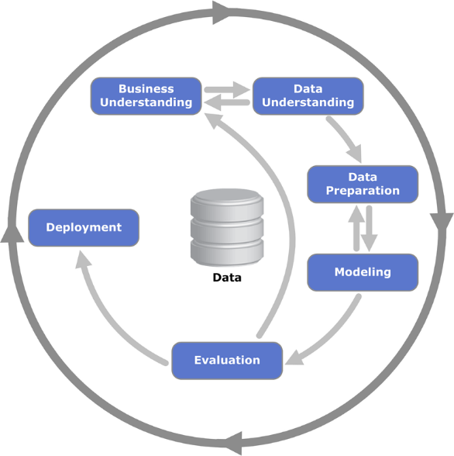
CRISP-DM
Goal Definition
Test and learn
C ross
I ndustry S tandard
P rocess for
D ata
M ining
operationalize
Knowledge Application
Notes:
How do we approach analytics in a repeatable and reliable way?
In 1997, industry leaders gathered to compose guidelines for data mining practices across industries. Over two years, supported by the European Commission, this Special Interest Group developed the Cross Industry Standard Process for Data Mining, or, CRISP-DM.
CRISP-DM is a hierarchical process consisting of (6) top-level phases: Business Understanding, Data Understanding, Data Preparation, Modeling, Evaluation and Deployment. Each of these phases has general tasks which should always be done, e.g. Data Preparation phase includes the general task of cleaning data. Then in the third level are specialized tasks which may need to be completed during the process. Notice in the diagram that the specialized tasks are performed differently within your project as you iterate through the CRISP-DM cycle. These specialized tasks may be performed in a fluid manner, depending upon your project, its context and requirements, you may need to switch their order or omit certain tasks according to your project needs.
While your data may change and new modeling techniques may emerge, the CRISP-DM process is stable over such changes.
Performing the steps of CRISP-DM can take you from a lower level of analytics, like statistical analysis to a higher one like optimization and simulations. Following these guidelines will increase the likelihood of your getting useful analytic results.
Image Source: Pete Chapman (NCR), Julian Clinton (SPSS), Randy Kerber (NCR),
Thomas Khabaza (SPSS), Thomas Reinartz (DaimlerChrysler),
Colin Shearer (SPSS) and Rüdiger Wirth (DaimlerChrysler), CRISP-DM 1.0 Step by Step Data Mining Guide. SPSS, Inc. 2000.
**********
The six phases of CRISP-DM are:
Business Understanding
This first phase is where we gain an understanding of the project’s climate, business situation, and goals.
Data Understanding
Then, we want to start to understand what data is available to us: how to get to it and what it looks like.
Data Preparation
When we are ready, we start to work with the data, clean it up and get it ready to start modeling.
Modeling
This is the meaty part: figuring out what modeling techniques are appropriate for your data mining project, and then applying appropriate parameters to them.
Evaluation
Now you have your model, you need to check back with your Business Understanding of the terrain to make sure that it addresses your business goals and success criteria.
Deployment
With an evaluated model, you may think you’re done, but not yet! The model needs to be deployed and then operationalized.
The inner circle made of these six steps is our “Test and Learn” cycle. When we feel we’ve learned enough to deploy something, our model can be put into operational mode. The outer circle in the diagram is this process of keeping things operational. Over time we may get new types of data, come across new business questions, or learn about new modeling techniques. We need to return to the various CRISP-DM steps and continue to refine our data mining project/solution.
The CRISP-DM process is open ended. You may know where you are heading but you may not know how to get there.

Slide 6
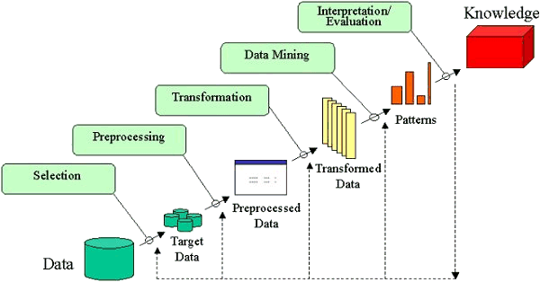
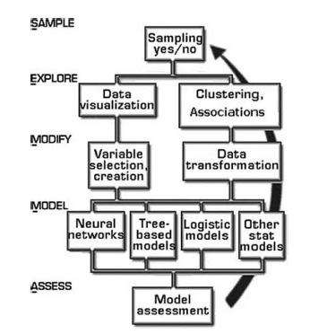
KDD
SEMMA
Notes:
KDD = Knowledge Discovery in Databases
SEMMA = Sample, Explore, Modify, Model and Assess
http://www.dataprix.net/en/blogs/respinosamilla/theory-data-mining
http://decisionstats.com/tag/knowledge-discovery/

Slide 7

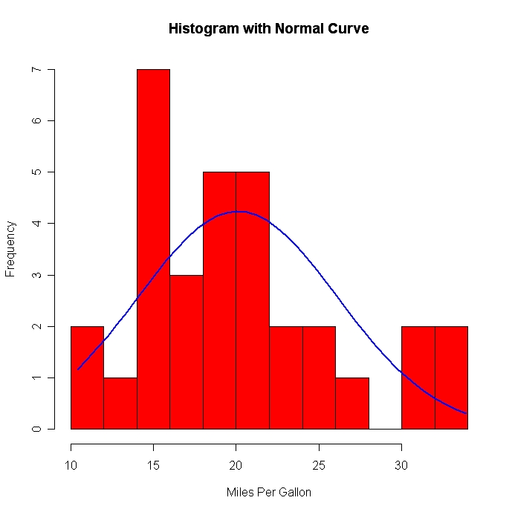

CRISP-DM
Business Understanding
Data Understanding
 | Sepal Length | Sepal Width | Petal Length | Petal Width
Mean | 5.84 | 3.05 | 3.76 | 1.20
Standard Error | 0.07 | 0.04 | 0.14 | 0.06
Median | 5.80 | 3.00 | 4.35 | 1.30
Mode | 5.00 | 3.00 | 1.50 | 0.20
Standard Deviation | 0.83 | 0.43 | 1.76 | 0.76
Sample Variance | 0.69 | 0.19 | 3.11 | 0.58
Kurtosis | -0.55 | 0.29 | -1.40 | -1.34
Skewness | 0.31 | 0.33 | -0.27 | -0.10
Range | 3.60 | 2.40 | 5.90 | 2.40
Minimum | 4.30 | 2.00 | 1.00 | 0.10
Maximum | 7.90 | 4.40 | 6.90 | 2.50
Sum | 876.50 | 458.10 | 563.80 | 179.80
Count | 150.00 | 150.00 | 150.00 | 150.00
Notes:
http://www.ssonetwork.com/transformation-innovation/columns/understanding-business-commercial-performance/
http://www.flaticon.com/free-icon/bald-head-with-lightbulb-with-exclamation-sign-inside_33183
Data understanding
Descriptives stats
Visualization (histograms) – important – anscombe’s quartet
hypotheses
Business Understanding
This first phase is where we gain an understanding of the project’s climate, business situation, and goals.
What questions do we need to answer?
Which questions are possible to answer?
What assumptions are we willing to make?
What assumptions can we not make?
What are our constraints/limitations?
Define the data mining problem using business objectives
What is success?
If deployed, are there any constraints?
Set benchmarks & measures
Data Understanding
Then, we want to start to understand what data is available to us: how to get to it and what it looks like.
Collecting and becoming more familiar with the data
Data understanding begins with collecting all of the data necessary to address the data mining objectives and then moves into specific activities that help paint a picture of the data as a whole:
Data Description, Data Exploration and Data Quality verification help us become more familiar with the data, discover initial insights, detect interesting subsets or features, form hypotheses, devise more detailed investigations, and identify solve-able problems.
Data Preparation
When we are ready, we start to work with the data, clean it up and get it ready to start modeling.
Modeling
This is the meaty part: figuring out what modeling techniques are appropriate for your data mining project, and then applying appropriate parameters to them.
Evaluation
Now you have your model, you need to check back with your Business Understanding of the terrain to make sure that it addresses your business goals and success criteria.
Deployment
With an evaluated model, you may think you’re done, but not yet! The model needs to be deployed and then operationalized.
The inner circle made of these six steps is our “Test and Learn” cycle. When we feel we’ve learned enough to deploy something, our model can be put into operational mode. The outer circle in the diagram is this process of keeping things operational. Over time we may get new types of data, come across new business questions, or learn about new modeling techniques. We need to return to the various CRISP-DM steps and continue to refine our data mining project/solution.
The CRISP-DM process is open ended. You may know where you are heading but you may not know how to get there.

Slide 8
CRISP-DM: Data Understanding and Preparation
Name | Age | State of Residence | Living Relatives | Age of Retirement | Serious Medical Conditions | Gender | Annual Social Security Benefit
John C. | 89 | NY | Y | 70 | Diabetes | Male | $32,000
Bill R. | 78 | Texas | NO | 68 | None | M | $24,000
Cliff J. | 76 | FL | Y | 56 | COPD | M | 18,000
Ann S. | 72 | 08 | Yes | 62 | Alzheimer's | F | $16720
Jill Q. | 71 | RI | N | 66 |  | Fm | $19,012.25
Name | Age | State of Residence | Living Relatives | Age of Retirement | Serious Medical Conditions | Gender | Annual Social Security Benefit
John C. | 89 | NY | Y | 70 | Diabetes | Male | $32,000
Bill R. | 78 | Texas | NO | 68 | None | M | $24,000
Cliff J. | 76 | FL | Y | 56 | COPD | M | 18,000
Ann S. | 72 | 08 | Yes | 62 | Alzheimer's | F | $16720
Jill Q. | 71 | RI | N | 66 | ? | F | $19,012.25
Name | Age | State of Residence | Living Relatives | Age of Retirement | Serious Medical Conditions | Gender | Annual Social Security Benefit
John C. | 89 | NY | Y | 70 | Diabetes | Male | $32,000
Bill R. | 78 | TX | NO | 68 | None | M | $24,000
Cliff J. | 76 | FL | Y | 56 | COPD | M | 18,000
Ann S. | 72 | 08 | Yes | 62 | Alzheimer's | F | $16720
Jill Q. | 71 | RI | N | 66 | ? | F | $19,012.25
Name | Age | State of Residence | Living Relatives | Age of Retirement | Serious Medical Conditions | Gender | Annual Social Security Benefit
John C. | 89 | NY | Y | 70 | Diabetes | Male | $32,000
Bill R. | 78 | TX | NO | 68 | None | M | $24,000
Cliff J. | 76 | FL | Y | 56 | COPD | M | 18,000
Ann S. | 72 | FL | Yes | 62 | Alzheimer's | F | $16720
Jill Q. | 71 | RI | N | 66 | ? | F | $19,012.25
Name | Age | State of Residence | Living Relatives | Age of Retirement | Serious Medical Conditions | Gender | Annual Social Security Benefit
John C. | 89 | NY | Y | 70 | Diabetes | Male | $32,000
Bill R. | 78 | TX | N | 68 | None | M | $24,000
Cliff J. | 76 | FL | Y | 56 | COPD | M | 18,000
Ann S. | 72 | FL | Yes | 62 | Alzheimer's | F | $16720
Jill Q. | 71 | RI | N | 66 | ? | F | $19,012.25
Name | Age | State of Residence | Living Relatives | Age of Retirement | Serious Medical Conditions | Gender | Annual Social Security Benefit
John C. | 89 | NY | Y | 70 | Diabetes | Male | $32,000
Bill R. | 78 | TX | N | 68 | None | M | $24,000
Cliff J. | 76 | FL | Y | 56 | COPD | M | 18,000
Ann S. | 72 | FL | Y | 62 | Alzheimer's | F | $16720
Jill Q. | 71 | RI | N | 66 | ? | F | $19,012.25
Name | Age | State of Residence | Living Relatives | Age of Retirement | Serious Medical Conditions | Gender | Annual Social Security Benefit
John C. | 89 | NY | Y | 70 | Diabetes | Male | $32,000
Bill R. | 78 | TX | N | 68 | None | M | $24,000
Cliff J. | 76 | FL | Y | 56 | COPD | M | 18,000
Ann S. | 72 | FL | Y | 62 | Alzheimer's | F | $16720
Jill Q. | 71 | RI | N | 66 | None | F | $19,012.25
Name | Age | State of Residence | Living Relatives | Age of Retirement | Serious Medical Conditions | Gender | Annual Social Security Benefit
John C. | 89 | NY | Y | 70 | Diabetes | M | $32,000
Bill R. | 78 | TX | N | 68 | None | M | $24,000
Cliff J. | 76 | FL | Y | 56 | COPD | M | 18,000
Ann S. | 72 | FL | Y | 62 | Alzheimer's | F | $16720
Jill Q. | 71 | RI | N | 66 | None | F | $19,012.25
Name | Age | State of Residence | Living Relatives | Age of Retirement | Serious Medical Conditions | Gender | Annual Social Security Benefit
John C. | 89 | NY | Y | 70 | Diabetes | M | $32,000
Bill R. | 78 | TX | N | 68 | None | M | $24,000
Cliff J. | 76 | FL | Y | 56 | COPD | M | $18,000
Ann S. | 72 | FL | Y | 62 | Alzheimer's | F | $16720
Jill Q. | 71 | RI | N | 66 | None | F | $19,012.25
Name | Age | State of Residence | Living Relatives | Age of Retirement | Serious Medical Conditions | Gender | Annual Social Security Benefit
John C. | 89 | NY | Y | 70 | Diabetes | M | $32,000
Bill R. | 78 | TX | N | 68 | None | M | $24,000
Cliff J. | 76 | FL | Y | 56 | COPD | M | $18,000
Ann S. | 72 | FL | Y | 62 | Alzheimer's | F | $16,720
Jill Q. | 71 | RI | N | 66 | None | F | $19,012.25
Name | Age | State of Residence | Living Relatives | Age of Retirement | Serious Medical Conditions | Gender | Annual Social Security Benefit
John C. | 89 | NY | Y | 70 | Diabetes | M | $32,000
Bill R. | 78 | TX | N | 68 | None | M | $24,000
Cliff J. | 76 | FL | Y | 56 | COPD | M | $18,000
Ann S. | 72 | FL | Y | 62 | Alzheimer's | F | $16,720
Jill Q. | 71 | RI | N | 66 | None | F | $19,012
Notes:
Data Prep = getting raw data ready for use in modeling (includes sampling and normalization / standardization)
Main analysis work of a typical project
How do we represent each of the variables in the table?
What form is best for the model we will use?
How will preparation steps alter the outcome of our analytics?
Each data set and project is unique
DP techniques should be thought of as a toolset rather than a strict recipe
Selecting Data (Select; Integrate data) and Cleaning Single Variables from Problems (Clean; Format data)
Create new features from existing variables (Construct data)
Reduce candidate inputs by removing redundant and irrelevant variables and features (Clean data)
Select Data
Clean Data
Construct Data
Integrate Data
Format Data
Cleaning data
Dealing with ROT
Filtering on a column
Filtering out a column
Dealing with special values
EX: surveys fill missing entries with 99
EX: values like 100 and 100,000 truncated to 00
Dealing with noise
Understanding and handling outliers
Estimating missing values (imputation)
So, at this point, even though we might have an understanding of our business goals, and maybe even data mining goals, we might still be a little bit foggy on what the “data” we are going to be using might look like? How is it organized? How are entries identified? What and where are the target or dependent variables? How are the variable values different?
Here we can see an example of “data” that we might receive in the form of a table. We can see that each student ID corresponds to a case. Each case has values for input or predictor variables that contribute to a target outcome that is also included in the table. And each of these variables, or attributes, have unique forms and values.
Looking at the table and getting a feel for its layout and organization is the first step in data understanding.

Slide 9
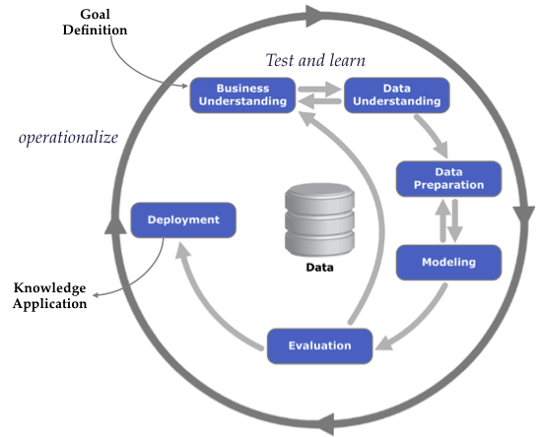
From Data to Implementation
Data Table
Model Build
Model Code
ID | Outcome | Input1 | Input2 | Input3
1 | N | 1.2 | h | 0
2 | Y | 7.5 | m | 1
3 | Y | 6.2 | h | 0
4 | N | 0.1 | l | 0
Y_hat = 3*x1 + sqrt(x7) /x32 …
New Real Cases
Regression
Decision Tree
Neural Net
…
ID | Input1 | Input2 | Input3
21 | 52 | m | 1
32 | 9.6 | l | 0
57 | 11 | h | 0
17 | 5.1 | l | 0
Organizational Constraints
Implementation Model
Decisions
Overlays
Schedules
IT requirements
Bus. framework
If (v AND Y_hat >0.5) then action = work;
ID | Y_hat | Action
21 | 0.89 | Work
32 | .44 | No work
57 | .67 | Work
17 | .13 | No work
Notes:
Next, before looking at any individual characteristics or attributes in greater detail, we should also put our initial insights about the data into a larger context by thinking about how the data and an understanding of its properties contributes to the overall project. Without context, the activities we take to improve data understanding may be useless or even confounding.
Here, we see a big picture of modeling flow. The data is used to decide which model might be most appropriate for selection. After constructing the model, it can be refined by considering any relevant organizational constraints and then implemented for predicting outcomes for new cases.
Seeing how the model building process starts with data, it is easy to think about how crucial an accurate data understanding is to the entire process. An errant step in the beginning can set the entire project off course. Therefore, we need to spend as much time as we think is necessary in solidifying our data understanding. This means taking advantage of the intertwined nature of business understanding, data understanding and the third step in CRISP-DM, Data Preparation, and allowing them to refine each other and our comprehension of the resources at our disposal.
For instance, the business objectives and project goals, along with the project plan established in business understanding, help us form data mining goals that lead us into Data Understanding. Knowing what data we might need from our data to tackle our business questions, we can focus on trying to find and understand that data thoroughly in Data Understanding’s Acquisition, Description and Exploration steps. Furthermore, Assessment of the Situation in Business Understanding will help us know what resources we can look to in order to gather data and gain insights into its meaning. We are also made aware in this step of Business Understanding of the risks and contingencies present in the data and the project, along with assumptions about requirements and constraints, that will significantly shape our understanding of data quality in Data Understanding.

Slide 10







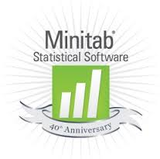


Statistical Software
Notes:
Free statistics and graphics environment that blurs the distinction between users and programmers
A system for interactive data analysis – queries, summaries, table views, graphical displays, outputs
High level programming language – scripts and functions that can be repeated
Good system for rapid development of statistical applications (time is money!)

Slide 11
What is R?
FREE statistics and graphics environment!
Interactive
High-level programming language
Allows for rapid development!
Notes:
Free statistics and graphics environment that blurs the distinction between users and programmers
A system for interactive data analysis – queries, summaries, table views, graphical displays, outputs
High level programming language – scripts and functions that can be repeated
Good system for rapid development of statistical applications (time is money!)

Slide 12
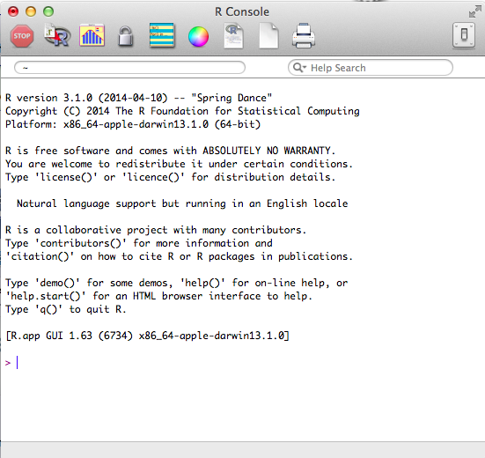
Basics of R
Downloadable:
http://www.r-project.org
Packages and libraries available
Shared resources
Notes:
R is freeware! So it can be downloaded from r-project.org for whatever operating system you have!
On this same website, you can also find an abundance of valuable resources
Tutorials and manuals
Downloadable packages that make statistical analyses and operations easy and available with simple, one-line commands
Shared resources (also available from other websites for the community of R users)

Slide 13
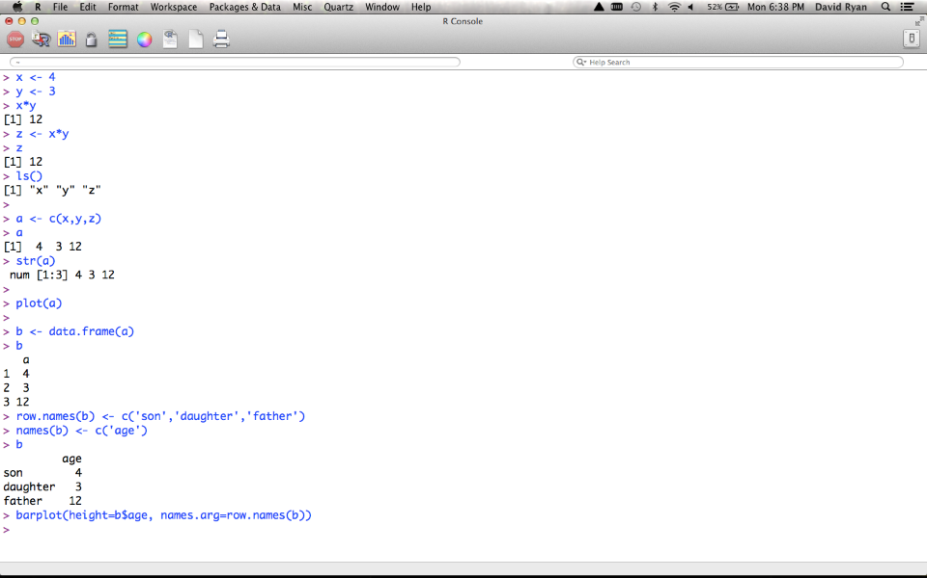
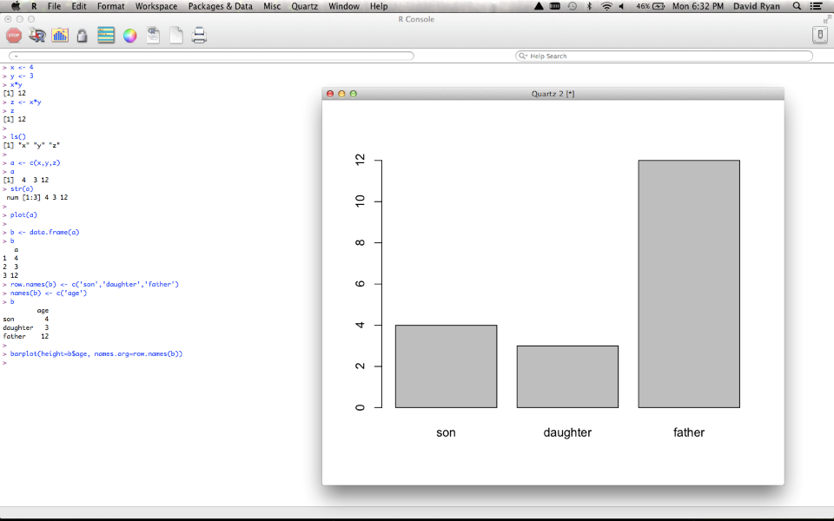
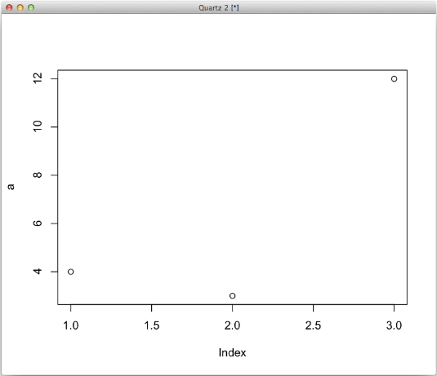
Basics of R
Notes:
Basic operations in R look much like those on your calculator!
- Assign values to variables & perform operations
Create lists (variable vectors)
Can create graphs from variables
Can modify tables for customized properties

Slide 14

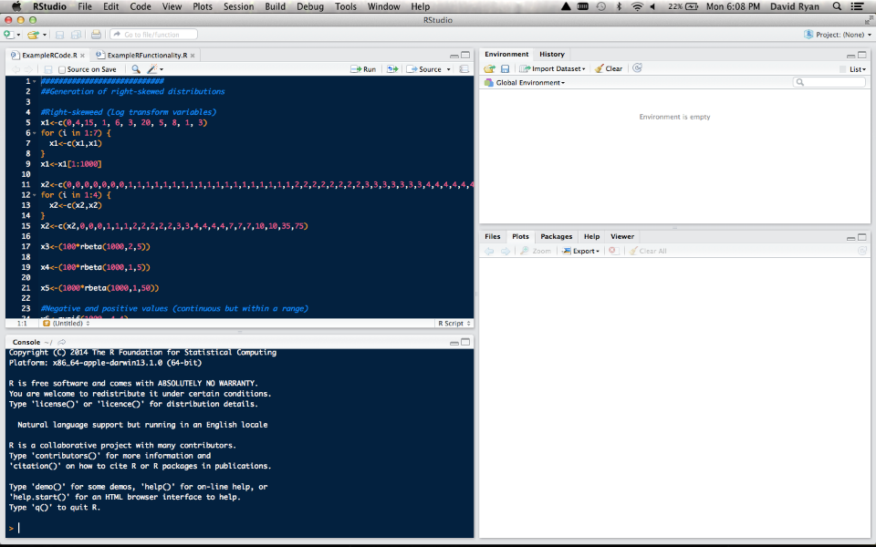
Notes:
This is all great, but with all of that typing, it can be easy to forget what you are working with
What if we could keep track of all of our variables, see code we were working on as well as executing and view graphs all in the same window?
Luckily there is Rstudio!
Can download at rstudio.com
Has a Console for executing live code
A window for scripting (saved code)
An environment to track variables and data
History to see lists of previous commands in case you clear your workspace
Multitab viewer for plots, packages, help, etc.

Slide 15
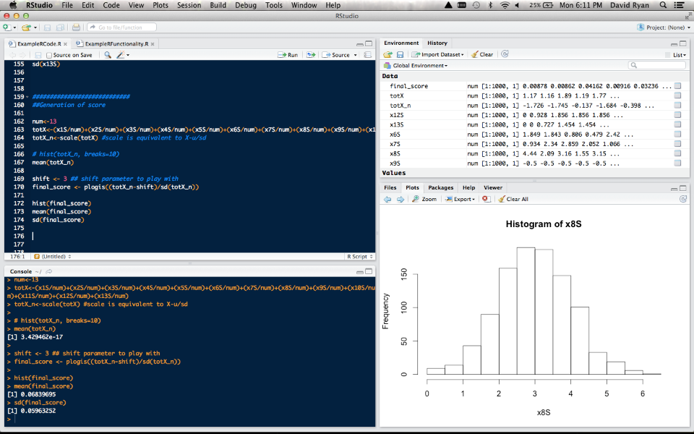
Notes:
As you can see here, Rstudio does much the same things as R, except it is all in one place!

Slide 16
What can R do?
Read data
Data summaries
Graphics
Scripts
Data summaries
Functions / Packages
Models
Notes:
Basic functionality
Reading data
Simple data summaries
Graphics
Scripts
Stratified data summaries
Functions and Packages
Models

Slide 17
Reading Data with R
Text files, data sets, web pages, databases
> salary2 <- read.table('Documents/RCourse/salary.txt', header=T)
> airquality2 <- read.table('Documents/RCourse/airquality.csv', header=T, sep=',')
Notes:
Working with tables and databases
All commands in R are treated equally – they all are functions and return values
These assign data to a variable
Functions have optional arguments that can be included or excluded based on data type (i.e. sep)
Storing data sets in variables allows more than one dataset to be available at any given time
We can get into lists of these common functions later, but it is often best to learn by playing around in R!

Slide 18
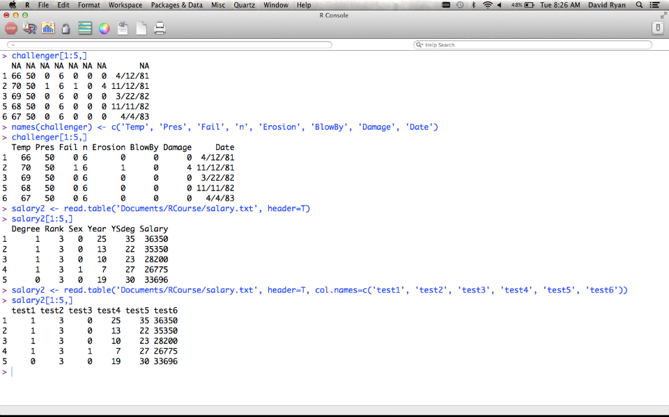
Reading Data with R
Notes:
Working with tables and databases
Here we see several examples of data tables (this time in R itself to simplify view)
Challenger is a data set included with R (many like this to play with)
Can access designated rows
Rename columns
Other function to note: Is.na()

Slide 19
Reading Data with R
psa <- read.table("psa.txt", col.names=c("ptid","nadirpsa",
"pretxpsa", "ps","bss","grade","age",
"obstime","inrem"))
psa <- read.table("psa.txt")
names(psa) <- c("ptid","nadirpsa","pretxpsa", "ps",
"bss","grade","age","obstime","inrem"))
fl2000<-read.table("http://faculty.washington.edu/tlumley/
data/FLvote.dat", header=TRUE)
Notes:
Working with tables and databases
Here we can just see different ways of reading data
- you can consolidate the processes we just went through by putting arguments into initial function!
- NOTE: you can also read data directly from the web

Slide 20
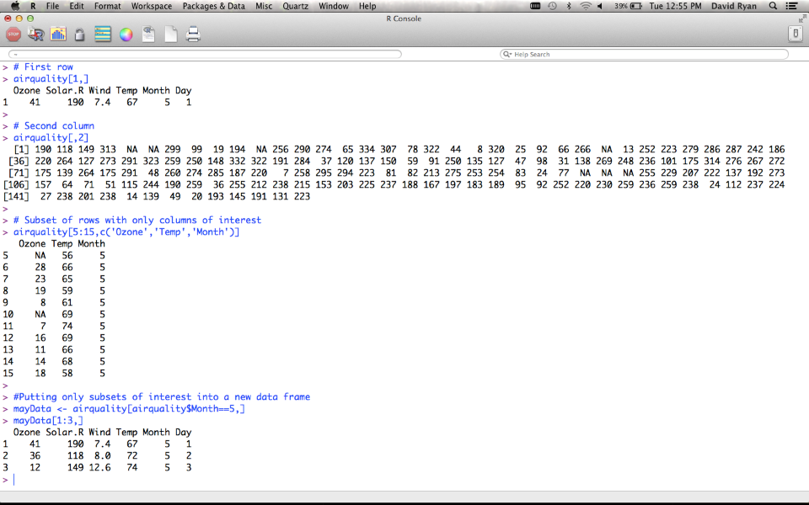
Data Subsets
Notes:
Here we see examples of accessing dataframe elements
Whole rows
Whole columns
Specific subset
Reassigning subset

Slide 21
Data Subsets
## First element
antibiotics$temp[1]
## All but first element
antibiotics$temp[-1]
## Elements 5 through 10
antibiotics$temp[5:10]
## Elements 5 and 7
antibiotics$temp[c(5,7)]
## People who received antibiotics antibiotics$temp[antibiotics$
antib==1 ]
## or
with(antibiotics, temp[antib==1])
## First row
antibiotics[1,]
## Second column
antibiotics[,2]
## Some rows and columns
antibiotics[3:7, 2:4]
## Columns by name
antibiotics[, c("id","temp","wbc")]
## People who received antibiotics
antibiotics[antibiotics$antib==1,]
## Put subset into a new data frame
yes <- antibiotics[antibiotics$antib==1,]
Notes:
Here are examples of calling items from a database
When you specify a variable, you only need one call number (because you have turned this into a vector)
When no variable is specified, you are still working with the whole dataframe, so you need to specify record (row) and column (variable)

Slide 22
Simple Data Summaries
mean(antibiotics$temp)
median(antibiotics$temp)
var(antibiotics$temp)
sd(antibiotics$temp)
mean(antibiotics$temp[antibiotics$antib==1]
with(antibiotics, mean(temp[sex==2]))
toohot <- with(antibiotics, temp>99)
mean(toohot)
Notes:
Working with tables and database: Last 3
Mean of temperature when there was an antibiotic used
Mean of temperature when sex=2 for the antibiotic data set
Mean of instances of cases within antibiotics when temperature>99 (percentage of the time this occurs)

Slide 23
Simple Data Summaries
> table(salary$rank,salary$field)
Arts Other Prof
Assist 668 2626 754
Assoc 1229 4229 1071
Full 942 6285 1984
> antibiotics$antib<-factor(antibiotics$antib,
labels=c("Yes","No"))
> antibiotics$agegp<-cut(antibiotics$antib, c(0,18,65,100))
> table(antibiotics$agegp)
(0,18] (18,65] (65,100]
2 19 4
Notes:
Working with tables and databases
- Factors represent categorical variables. You can’t do mathematical operations on them (except for ==)

Slide 24
Graphics
## scatterplot
plot(salary~year, data=salary)
## boxplot
plot(salary$rank, salary$salary)
## stacked barplot
plot(salary$field, salary$rank)
Notes:
plot() command can be written plot(salary~rank, data=salary)
Formula system
Or in plot(x,y)
Demo with demo(graphics)

Slide 25
Scripts & Functions
Notes:
Working with tables and databases

Slide 26
Need more help?
help(fn)
help.search("topic")
apropos("tab")
Search function on http://www.r-project.org
Notes:
Conclusion

Slide 27
Notes:
Conclusion

Slide 28
http://faculty.washington.edu/tlumley/Rcourse/R-fundamentals.pdf
Notes:
Conclusion

Slide 29
Simple Data Summaries
Functions for searching and modifying strings are based on
reg-
ular expressions
, which are like simple programs for representing
strings
"a"
matches the letter
a
"TATAA"
matches the string
TATAA
"ACGT.C"
matches
ACGT
followed by any single character,
followed by
C
"a*b*"
matches zero or more
a
s followed by zero or more
b
s
"[A-Za-z]+"
matches one or more characters between
A
and
Z
or between
a
and
z
(in English, any letter).
"[[:alpha:]]+"
matches one or more letters, defined according
to the current locale
"\\.csv$"
matches the string
.csv
at the end of a string
"([[:alpha:]]+)[[:space:][:punct:]]+\\1[[:space:][:punct:]]+"
matches any repeated word.
grep(regexp, vector)
finds all the strings in the vector that
contain a substring matching the regular expression
•
sub(regexp, replacement, vector)
replaces the first substring
matching the regular expression with the replacement (for
each element of the vector).
gsub
does the same thing but
can make more than one replacement per string
•
regexpr(regexp, vector)
returns the position of the first
match within each string,
gregexpr
is the same except that
it returns all matches.
•
strsplit()
splits a string at each match to a regular
expression
•
glob2rx()
converts filename wildcard specifications to regular
expressions
Notes:
Working with tables and databases

Slide 30
NOTES
Notes:
Conclusion

Slide 31
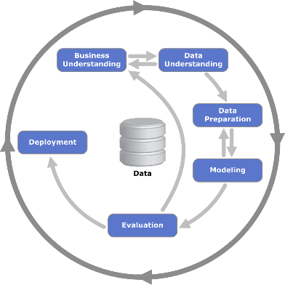
NOTES RESOURCES
CRISP-DM (Cross Industry Standard Process for Data Mining) ^{[1]} is a data mining process model that describes commonly used approaches that data mining experts use to tackle problems. Polls conducted in 2002, 2004, and 2007 show that it is the leading methodology used by data miners.^{[2][3][4]} The only other data mining standard named in these polls was SEMMA. However, 3-4 times as many people reported using CRISP-DM. A review and critique of data mining process models in 2009 called the CRISP-DM the "de facto standard for developing data mining and knowledge discovery projects."^{[5]} Other reviews of CRISP-DM and data mining process models include Kurgan and Musilek's 2006 review,^{[6]} and Azevedo and Santos' 2008 comparison of CRISP-DM and SEMMA.^{[7]}
CRISP-DM breaks the process of data mining into six major phases.^{[8]}
The sequence of the phases is not strict and moving back and forth between different phases is always required. The arrows in the process diagram indicate the most important and frequent dependencies between phases. The outer circle in the diagram symbolizes the cyclic nature of data mining itself. A data mining process continues after a solution has been deployed. The lessons learned during the process can trigger new, often more focused business questions and subsequent data mining processes will benefit from the experiences of previous ones.
Business Understanding
This initial phase focuses on understanding the project objectives and requirements from a business perspective, and then converting this knowledge into a data mining problem definition, and a preliminary plan designed to achieve the objectives.
Data Understanding
The data understanding phase starts with an initial data collection and proceeds with activities in order to get familiar with the data, to identify data quality problems, to discover first insights into the data, or to detect interesting subsets to form hypotheses for hidden information.
Data Preparation
The data preparation phase covers all activities to construct the final dataset (data that will be fed into the modeling tool(s)) from the initial raw data. Data preparation tasks are likely to be performed multiple times, and not in any prescribed order. Tasks include table, record, and attribute selection as well as transformation and cleaning of data for modeling tools.
Modeling
In this phase, various modeling techniques are selected and applied, and their parameters are calibrated to optimal values. Typically, there are several techniques for the same data mining problem type. Some techniques have specific requirements on the form of data. Therefore, stepping back to the data preparation phase is often needed.
Evaluation
At this stage in the project you have built a model (or models) that appears to have high quality, from a data analysis perspective. Before proceeding to final deployment of the model, it is important to more thoroughly evaluate the model, and review the steps executed to construct the model, to be certain it properly achieves the business objectives. A key objective is to determine if there is some important business issue that has not been sufficiently considered. At the end of this phase, a decision on the use of the data mining results should be reached.
Deployment
Creation of the model is generally not the end of the project. Even if the purpose of the model is to increase knowledge of the data, the knowledge gained will need to be organized and presented in a way that the customer can use it. Depending on the requirements, the deployment phase can be as simple as generating a report or as complex as implementing a repeatable data scoring (e.g. segment allocation) or data mining process. In many cases it will be the customer, not the data analyst, who will carry out the deployment steps. Even if the analyst deploys the model it is important for the customer to understand up front the actions which will need to be carried out in order to actually make use of the created models.
http://en.wikipedia.org/wiki/Cross_Industry_Standard_Process_for_Data_Mining#mediaviewer/File:CRISP-DM_Process_Diagram.png
Notes:
CRISP-DM was conceived in 1996. In 1997 it got underway as a European Union project under the ESPRIT funding initiative. The project was led by five companies: SPSS, Teradata, Daimler AG, NCR Corporation and OHRA, an insurance company.
This core consortium brought different experiences to the project: ISL, later acquired and merged into SPSS Inc. The computer giant NCR Corporation produced the Teradata data warehouse and its own data mining software. Daimler-Benzhad a significant data mining team. OHRA was just starting to explore the potential use of data mining.
The first version of the methodology was presented at the 4th CRISP-DM SIG Workshop in Brussels in March 1999,^{[9]} and published as a step-by-step data mining guide later that year.^{[10]}
Between 2006 and 2008 a CRISP-DM 2.0 SIG was formed and there were discussions about updating the CRISP-DM process model.^{[5][11]} The current status of these efforts is not known. However, the original crisp-dm.org website cited in the reviews,^{[6][7]} and the CRISP-DM 2.0 SIG website^{[5][11]} are both no longer active.
While many non-IBM data mining practitioners use CRISP-DM,^{[2][3][4][5]} IBM is the primary corporation that currently embraces the CRISP-DM process model. It makes some of the old CRISP-DM documents available for download^{[10]} and it has incorporated it into its SPSS Modeler product.

Slide 32
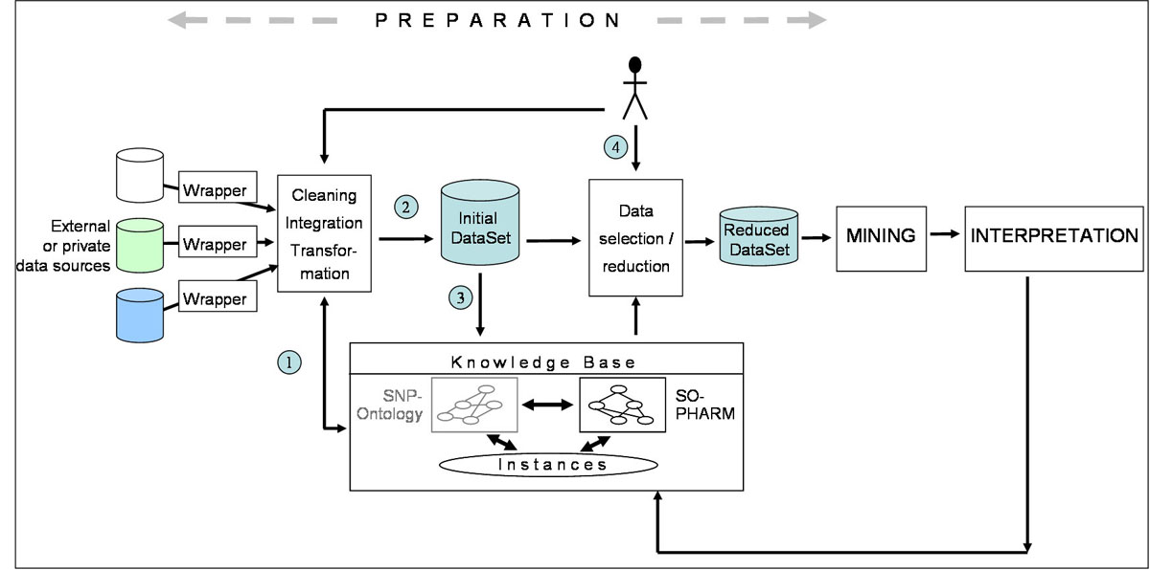
Notes:
http://www.biomedcentral.com/1471-2105/9/S4/S3/figure/F1?highres=y
Overview of the proposed method The KDD process is divided into three main steps: data preparation, data mining, and data interpretation. The figure details data preparation within the KDD process and illustrates our method of data selection guided with domain knowledge. Data relevant to the study are collected from various resources such as genomic variation databases, published pharmacogenomic studies and private datasets. Various operations are applied to these data: cleaning, integration and transformation. Theses operations implies first an instantiation of a knowledge base (1), and second the design of the “initial dataset”(2). In this study, a dataset is defined as a relation between set of objects (rows) and set of attributes (columns). A mapping is then built between objects and attributes of this dataset and the instances from the KB (3). Data selection results from the definition of a subset of instances in the KB (4), allowing the selection of corresponding objects and attributes, with respect to the mapping. This process takes as inputs the initial dataset and the KB is controlled by the domain expert, and yields the “reduced dataset”. Characteristics of the ontology such as subsumption relationships, properties and class descriptions, are used to guide the definition of meaningful instance subsets. These subsets are in turn used for data selection. Data mining algorithms are then applied to the reduced dataset. The results of the mining operation are interpreted in terms of knowledge units that can be eventually integrated into the knowledge base.

Slide 33
DataMining techniques
Statistical analysis:
Using the following tools: 1.ANOVA: o Analysis of Variance, to see whether there are significant differences between the measures of one or more continuous variables in different population groups.
2.Regresión: defines the relationship between one or more variables and a set of predictors of the first.
3.Ji squared tests the hypothesis of independence between variables.Main components: Reduce the number of observed variables to a smaller number of artificial variables, retaining most of the information on the variance of the variables.
4.Análisis cluster: To classify a population in a number of groups, based on profile similarities and dissimilarities between the different components of that population.
Discriminant 5.Análisis: A method of classification of individuals into groups that have previously been established, and find the rule that allows classification of the elements of these groups, and therefore identify the variables that best define the group membership.
Methods based on decision trees:
The method CHAID (Chi Squared Automatic Interaction Detector) is an analysis that generates a decision tree to predict the behavior of a variable from one or more predictor variables, so that the sets of the same branch and the same level are disjoint.It is useful in situations where the objective is to divide a population into different segments based on some decision criterion.
The decision tree is constructed by splitting the dataset into two or more subsets of observations from the values ​​assumed predictors. Each of these subsets back then be partitioned using the same algorithm. This process continues until there are significant differences in the influence of predictive variables of these groups to the value of the response variable.
The root of the tree is the full data set, subsets and subsubconjuntos up tree branches.A set in which a partition is called node.
The number of subsets in a partition can go two to the number of distinct values ​​that can take the variable used for separation. The predictor variable used to create a partition is the one most significantly associated with the response variable under test of independence of the Chi square on a contingency table.
Genetic algorithms:
Are numerical optimization methods, in which variable or variables that are intended to improve along with the study variables are a piece of information.Those configurations of the variables of analysis to obtain best values ​​for the response variable, correspond to the segments with greater reproductive capacity. Through play, the best segments remain and their share grows from generation to generation. It can also introduce random elements for changing the variables (mutations). After a certain number of iterations, the population will consist of good solutions to the optimization problem.
Neural Networks:
Are generally numerical methods in parallel processing, in which the variables interact with linear or nonlinear transformations, to obtain a throughput.These outputs are compared with those who should have gone out, relying on test data, resulting in a feedback process by which the network is reconfigured so as to obtain a suitable model.
Neuronal Network Microstrategy
Fuzzy logic:
It is a generalization of the concept of statistics.Classical statistics is based on probability theory, turn it in joint technical, in which the relation of belonging to a set is dichotomous (the 2 is even or not). If we establish the notion of fuzzy set as one in which the membership has a certain level ("one day to 20 º C is hot?) We will have a broader statistical and so results are closer to human reasoning.
Time Series
Is knowledge of a variable through time, from that knowledge, and under the assumption that no structural changes will occur, to make predictions.Often based on a study of the series in cycles, trends and seasonality, which differ by the scope of time covered, for by obtaining the original series ended. Hybrid approaches can be applied to previous methods, in which the series can be explained not only in terms of time but as a combination of other variables more stable environment and, therefore, more easily predictable.
Notes:
http://www.dataprix.net/en/blogs/respinosamilla/theory-data-mining

Slide 34
Classification of data mining techniques
Data mining techniques can be classified as Association, Classification, Clustering and Time Series Predictions.
Association (Association): the relation between an item of a transaction and another item in the same transaction is used to predict patterns.For example, a customer purchases a computer (X) while buying a mouse (Y) by 60% of cases. This pattern occurs in 5.6% of purchases of computers. The association rule in this situation is that "X implies Y, where 60% is the confidence factor and 5.6% the support factor. When the confidence factor and support factor are represented by linguistic variables high and low, the association rule can be written in the form of fuzzy logic, such as "when the support bracket factor is low, X implies Y is high" . This would be a typical example of data mining to study the association between supermarkets selling baby diapers and beer (see blog entry Bifacil).Algorithms used association rules and decision trees.
Model Association in Microstrategy - Buy DVD Movies
Classification (classification) in the standings, the methods they intend to learn different features that classify the data into a predefined set of classes.Given a new predefined classes, a number of attributes and a set of training data or training, methods of classification can automatically predict the class of previously classified data. The more key issues related to the classification are the evaluation of the errors of classification and prediction power. The most used mathematical techniques for classification are binary decision trees, neural networks, linear programming and statistics. Using a binary decision tree, a tree induction model in the form Si-No, we can position the data in different classes depending on the value of its attributes.However, this classification may not be optimal if the power of prediction is low. Using neural networks, one can construct a model of neural induction. In this model, attributes are input layers and classes associated with the data is output layers. Between layers of input and output are a large number of hidden connections that ensure the reliability of the classification (as if they were the connections of a neuron with those around you). The neural induction model gives good results in many analysis data mining, when a large number of relationships complicates the implementation of the method for the large number of attributes.Using linear programming techniques, the classification problem is viewed as a special case of linear programming. Linear programming optimizes the classification of the data, but can lead to complex models that require large computation time. Other statistical methods such as linear regression, discriminant or logistic regression are also popular and frequently used in the classification process .
Decision Tree in Microstrategy
Clustering (Segmentation): The cluster analysis of data without taking group and by using automated techniques makes the grouping of these.The clustering is not supevisado and requires no training data set. Shares a set of methodologies with the classification. That is, many of the mathematical models used in the classification can be also applied to cluster analysis. Using clustering algorithms and clustering sequence.
Prediction (forecasting) / Estimate: prediction analysis is related to regression techniques.The main idea of ​​predictive analysis is to discover the relationships between dependent and independent variables and the relationships between independent variables. For example, if sales is an independent variable, the benefición can be a dependent variable.
Time Series (prognosis): using historical data together with techniques of linear or nonlinear regression, we can produce regression curves were used to make predictions for the future. Algorithms using time series.
Example 1. Analysis basket (Association).
Is a typical example used to explain the field of use of data mining (with the association between the sale of baby diapers and beer).In our case, using the examples provided by MicroStrategy in their platform, learning project, called MicroStrategy Tutorial, we will see an example of using association analysis techniques.
In the example, we analyze the sales of DVD's from a department store and try to find the association between sales of different movies. That is, try to find titles are sold together with the aim of establishing trade promotion then these films (eg, sale of packs, the location of the movies together in the hallways, discount promotion by buying the second unit, etc. ) with the aim of increasing sales.For this type of analysis used analysis of association rules.
Example 2. Customer segmentation (cluster analysis).
With this analysis we analyze our customers and using them demographic information (age, education, number of children, marital status or household type), make market segmentation to prepare the launch of certain products or making promotional offers.
In this case, we will conduct a cluster analysis using the algorithm k-means , which is the supporting Microstrategy.
Example 3.Sales forecast in a campaign (decision tree).
In this analysis using a decision tree to determine the response of a particular group of customers rebates on certain products in the era of back to school. To this end, decision trees use binary (remember that the decision trees can be used both for classification and for regression analysis, as in this case). Try to determine how they influence factors such as age, sex or number of children on the probability of shopping in the sales campaign.
Notes:
http://www.dataprix.net/en/blogs/respinosamilla/theory-data-mining

Slide 35
Key Components of Business Understanding
Business Understanding
Data Understanding
Modeling
Evaluation
Deployment
Data Preparation
Business Understanding
Goal: Understand what the end user wants to accomplish
Business Objectives
Assess Situation
Determine Data Mining Goals
Produce Project Plan
Notes:
Business Understanding is more of an art than it is a science. It requires creativity and collaboration between the various stakeholder groups. These will be conversations in which you involve as many stakeholders as possible to:
Determine business objectives of the project: what will make this project a success?
(Background and Business Success Criteria)
Gaining a background understanding and other information from SME’s
Assess the requirements and assumptions and constraints at play in your organization/team as well as resources at your disposal
Inventory Resources
Requirements Assumptions & Constraints
Risks and Contingencies
Terminology
Costs & Benefits
Take into consideration risks and other contingencies that may get in the way of your project
Determine Data Mining Goals: data mining and business goals
Data Mining Goals
Data Mining Success Criteria
Putting this information together with an assessment of available tools and techniques into a project plan
Initial Assessment of Tools and Techniques
Project Plan
Without a business objective there is no data mining.

Slide 36

Assess Situation: Requirements, Assumptions and Constraints
What questions do we need to answer?
Which questions are possible to answer?
What assumptions are we willing to make?
What assumptions can we not make?
What are our constraints/limitations?
Notes:
Which questions is it actually possible to answer?
EX: Dustin’s project for film making company- trying to find the optimal time to film fall foliage in Virginia. One question they posed was, “When and where can we expect the peak leaf color?” This is still an ambiguous question to answer. A better question may be, “When and where can we find the most color diversity in leaves?”
Assumptions can be about data or about the business itself
EX: Filming foliage, we assume that they pick a clear day to film, and that maximum leaf color diversity is desired
Constraints may be related to resources or technology. Are you limited to existing data? Can you change the data collection scheme?
EX: Filming foliage: Filming in only one location (maybe a specific location)
*************************************************************************************
Image Source: http://www.lovethesepics.com/

Slide 37
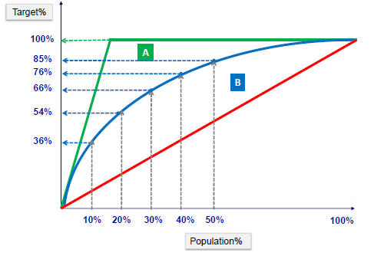
Determine Data Mining Goals: Data Mining Goals
Define the data mining problem using business objectives
What is success?
If deployed, are there any constraints?
Set benchmarks & measures
lift chart
Ideal model
Actual model
Random
Notes:
Mapping business objectives to data mining goals.
Success
How much work do you have to do to get the desired response? (lift chart)
Trade-off between accuracy and interpretability: what is more important for the organization?
Deployment Constraints
EX: Deployment of a model at the IRS, must be in a rule-based system. Needs to be able to be explained to non-technical stakeholders or end-users, or in a court of law.
Benchmarks and Measures
Technical measures that we make on a model like Bayesian Information Criterion (BIC), Akaike Information Criterion (AIC), collinearity, etc. We measure the accuracy of the model- to optimize it in the data mining sense
Then we have to make adjustments of model to the business.
Lift Chart
This shows what the model does for you, compared to random chance. The red diagonal line going across the chart represents random chance, or the case where mailing X% of recipients will return X% of revenue. The blue curved line, representing the model is “lifted” above random chance, An ideal model would be a line which reaches 100% at the point where we could possibly hit that much. For example, if only 15% of people who receive mailings end up purchasing widgets, a perfect model would identify that 15% perfectly, and we would only mail to the people who are sure to purchase our widgets.
The Lift Chart helps to answer questions about return on investment and model value.
****************************************************************************************
Image Source: http://www.saedsayad.com/model_evaluation_c.htm

Slide 38
Stage 2
Data Understanding
Notes:
The next step of the CRISP-DM process is focused on collecting and becoming more familiar with data in a process known as Data Understanding.

Slide 39
Data Structure for Data Mining
Analytic Base Table
Inputs
Key ID
Target Outcome
Treatments
Covariates
Student ID | Grade | Instructor | Lab Available | Teaching Assistant | Overall GPA | Gender | Prereq. Grade
Sue B. | B | Hall | Y | Turley | 3.5 | F | A
Bryce | A | Smith | N | Ace | 3.2 | M | B
Jean | C | Hall | Y | Mary | 3.0 | M | C
Ann | B | Turner | Y | Mary | 3.8 | F | B
Bob | A | Hall | N | Turley | 3.3 | M | A
Notes:
So, at this point, even though we might have an understanding of our business goals, and maybe even data mining goals, we might still be a little bit foggy on what the “data” we are going to be using might look like? How is it organized? How are entries identified? What and where are the target or dependent variables? How are the variable values different?
Here we can see an example of “data” that we might receive in the form of a table. We can see that each student ID corresponds to a case. Each case has values for input or predictor variables that contribute to a target outcome that is also included in the table. And each of these variables, or attributes, have unique forms and values.
Looking at the table and getting a feel for its layout and organization is the first step in data understanding.

Slide 40
From Data to Implementation
Data Table
Model Build
Model Code
ID | Outcome | Input1 | Input2 | Input3
1 | N | 1.2 | h | 0
2 | Y | 7.5 | m | 1
3 | Y | 6.2 | h | 0
4 | N | 0.1 | l | 0
Y_hat = 3*x1 + sqrt(x7) /x32 …
New Real Cases
Regression
Decision Tree
Neural Net
…
ID | Input1 | Input2 | Input3
21 | 52 | m | 1
32 | 9.6 | l | 0
57 | 11 | h | 0
17 | 5.1 | l | 0
Organizational Constraints
Implementation Model
Decisions
Overlays
Schedules
IT requirements
Bus. framework
If (v AND Y_hat >0.5) then action = work;
ID | Y_hat | Action
21 | 0.89 | Work
32 | .44 | No work
57 | .67 | Work
17 | .13 | No work
Notes:
Next, before looking at any individual characteristics or attributes in greater detail, we should also put our initial insights about the data into a larger context by thinking about how the data and an understanding of its properties contributes to the overall project. Without context, the activities we take to improve data understanding may be useless or even confounding.
Here, we see a big picture of modeling flow. The data is used to decide which model might be most appropriate for selection. After constructing the model, it can be refined by considering any relevant organizational constraints and then implemented for predicting outcomes for new cases.
Seeing how the model building process starts with data, it is easy to think about how crucial an accurate data understanding is to the entire process. An errant step in the beginning can set the entire project off course. Therefore, we need to spend as much time as we think is necessary in solidifying our data understanding. This means taking advantage of the intertwined nature of business understanding, data understanding and the third step in CRISP-DM, Data Preparation, and allowing them to refine each other and our comprehension of the resources at our disposal.
For instance, the business objectives and project goals, along with the project plan established in business understanding, help us form data mining goals that lead us into Data Understanding. Knowing what data we might need from our data to tackle our business questions, we can focus on trying to find and understand that data thoroughly in Data Understanding’s Acquisition, Description and Exploration steps. Furthermore, Assessment of the Situation in Business Understanding will help us know what resources we can look to in order to gather data and gain insights into its meaning. We are also made aware in this step of Business Understanding of the risks and contingencies present in the data and the project, along with assumptions about requirements and constraints, that will significantly shape our understanding of data quality in Data Understanding.

Slide 41
Key Components of Data Understanding
Business Understanding
Data Understanding
Modeling
Evaluation
Deployment
Data Preparation
Data Understanding
Data Acquisition
Data Description
Data Exploration
Data Quality
Notes:
In this lesson, we will stress the importance of spending time focusing on data understanding before proceeding with data preparation. Data Understanding findings will effectively guide you through preparation steps and prevent valuable time from being wasted in trial and error.
Data understanding begins with collecting all of the data necessary to address the data mining objectives and then moves into specific activities that help paint a picture of the data as a whole:
Data Description, Data Exploration and Data Quality verification help us become more familiar with the data, discover initial insights, detect interesting subsets or features, form hypotheses, devise more detailed investigations, and identify solve-able problems.
Data Acquisition:
Data Description
Data Exploration
Data Quality
Data Description
Data Exploration
Data Quality
Data Exploration
Form and Verify Initial Hypotheses
Initial Data Exploration Report
Data Quality
Inconsistencies
Missing Values
Outliers
Initial Data Quality Report

Slide 42
Data Acquisition: Data Selection
Which attributes are necessary?
Which attributes are irrelevant?
How many attributes can be used with chosen technique?
Name | Address | City | State | Zipcode | Product | Sales Date
John Brown | 1234 E St. | Chicago | IL | 60610 | Mower | 1/3/2007
John Brown | 1234 E St. | Chicago | IL | 60610 | Rake | 4/16/2006
Neal Smith | 300 Day St. | Houston | TX | 77091 | Shovel | 8/23/2005
Jean Blois | 325 Clay St. | Portland | OR | 97201 | Hoe | 9/28/2007
Name | Address | City | State | Zipcode | Product | Sales Date
John Brown | 1234 E St. | Chicago | IL | 60610 | Mower | 1/3/2007
John Brown | 1234 E St. | Chicago | IL | 60610 | Rake | 4/16/2006
Neal Smith | 300 Day St. | Houston | TX | 77091 | Shovel | 8/23/2005
Jean Blois | 325 Clay St. | Portland | OR | 97201 | Hoe | 9/28/2007
Name | Address | Zipcode | Product | Sales Date
John Brown | 1234 E St. | 60610 | Mower | 1/3/2007
John Brown | 1234 E St. | 60610 | Rake | 4/16/2006
Neal Smith | 300 Day St. | 77091 | Shovel | 8/23/2005
Jean Blois | 325 Clay St. | 97201 | Hoe | 9/28/2007
Name | Address | City | State | Zipcode | Product | Sales Date
John Brown | 1234 E St. | Chicago | IL | 60610 | Mower | 1/3/2007
John Brown | 1234 E St. | Chicago | IL | 60610 | Rake | 4/16/2006
Neal Smith | 300 Day St. | Houston | TX | 77091 | Shovel | 8/23/2005
Jean Blois | 325 Clay St. | Portland | OR | 97201 | Hoe | 9/28/2007
Notes:
We can use the same data sample to illustrate the principals data selection, which are beneficial in establishing a firm data understanding by eliminating unnecessary information that can cloud the relevant data.
First of all, we must have a clear vision of what data we are looking for to solve our business problems and achieve our data mining goals. Data selection hinges on highlighting the data we really need to make educated, informed business decisions. In order to achieve these goals, we must plan out which information is needed and check to see if that information is available in the gathered data.
If all of the information we think we need to address our data mining goals is in the gathered data, we can begin to establish specific selection criteria. First, we should specify which attributes are necessary and thus should be kept. Those include target attributes for supervised modeling. Next, we should identify irrelevant or superfluous attributes and remove them from the data set being analyzed. The focus should be on redundant, obsolete or trivial variables. Finally, we should consider restrictions on number of attributes, number of records and variable value properties and adjust the data set accordingly before deeming the combined data structure suitable for input into the data mining tool.
Later Data Preparation steps will further transform data to meet modeling needs by performing actions like recoding variables, transforming them to fit different distributions, or adjusting weights. While there is a thin line between these Data Preparation processes and the Data Selection steps of Data Understanding, they can, and should be separated as previously stated. The simple, preliminary steps of Data Selection and Data Integration are critical components of Data Understanding as they allow us to view the raw data in its final form and establish accurate understandings that are not clouded by unnecessary variables, duplicate records or disparate tables and sources.

Slide 43
Data Description
Anderson-Darling Normality Test
 |  | A-Squared |  | 2.049
 |  | P-Value |  | 0.000
 |  | Mean |  | 21.7874
 |  | St Dev |  | 12.1349
 |  | Variance |  | 147.256
 |  | Skewness |  | 0.668400
 |  | Kurtosis |  | 3.28E-0.3
 |  | N |  | 207
 |  | Minimum |  | 1.0000
 |  | 1st Quartile |  | 13.0000
 |  | Median |  | 21.0000
 |  | 3rd Quartile |  | 28.0000
 |  | Maximum |  | 56.0000
95% Confidence Interval for Mu
 | 20.1246 |  | 23.4503
95% Confidence Interval for Sigma
 | 11.0677 |  | 13.4316
95% Confidence Interval for Median
 | 18.0000 |  | 22.0000
Variable properties
Descriptive
Statistics
Querying
Univariate analysis
Visualization
Reporting
Techniques
iSixSigma.com
Notes:
After listing our gathered tables, descriptions can be provided for their individual fields. For instance, attribute names, and their relationships to business objectives and data mining goals should be noted. Other important features of attributes should also be examined, such as units, value ranges, and value types (numeric vs. text vs. symbolic), as well as any overlaps or similarities with other variables that were not accounted for in data selection (such as “low fat” and “diet”). Going through as many records as possible helps us get a good feel for the variables and what influence or role they might have in the eventual model.
After we have a thorough qualitative description of the data, we may further investigate nuances by calculating basic descriptive statistics. While often preliminary in terms of the overall analysis in the project, descriptive statistics can give us insight into the complexity of our data. For instance, these numbers can tell us about the central tendency of attribute variables, the distribution of values around the mean, variable balance, and the potential for outliers or interesting phenomena mixed in with the rest of the responses for a field. All of these quantitative investigations into properties of individual variables fall into the category of univariate analysis.
While univariate analysis can give you quantitative insights into individual variable properties, you may often be interested in how two variables…or even multiple variables…are related. This requires multivariate analysis (bivariate for two variables).
Exploring variable relationships through quantitative, multivariate analyses along with qualitative variable descriptions can help you identify any previously unseen patterns or redundancies among variables in the data set. More importantly, however, insights from these data descriptions will guide us in preparing data for modeling.

Slide 44
Data Exploration
Descriptive Statistics
Minimum | 0
Maximum | 454
Average | 6.17
Standard Deviation | 19.78
Visualization helps choose data values
Should suspicious cases be included?
Notes:
So what kind of visualizations highlight features of previous data gathered? For instance, what if we have intriguing findings from basic descriptive statistics or univariate analyses in Data Description activities?
Well, histograms allow us to see how our data is distributed and visualize any skewness or non-normalness in the data. Additionally, we can visually compare the generated histogram to a standard distribution curve to see how well a model might approximate data values.
Box-cox plots of distributions and confidence interval charts can help us further explore how our data is distributed and start to form ideas about how to prepare data for modeling.
>>>>>>>>
This should raise suspicions for us as analysts. Are these values making up the distribution’s tail important to model performance or can they be eliminated from consideration as noise? Looking at the data on a different scale can sometimes help us understand what is going on more thoroughly. Also, knowledge of the data from subject matter experts established in earlier data understanding efforts will help us decide how to set thresholds for choosing data values if we decide to eliminate some of the points in the distribution tail. We may, however, choose not to execute any data selection based on exploration of the graph. Still, viewing distribution graphs may help us choose appropriate modeling techniques. For instance, histograms that appear to represent normally distributed data match well with ordinary linear regression while histograms that are skewed to the right with a negative exponential curve (like the one above) lend themselves well to logistic regression models.

Slide 45

Data Exploration: Form Hypothesis
Data Descriptions
Business Goals
Data Mining Goal
Hypothesis
Questions
Actions
npr.org
Notes:
So, as we have seen, the insights gained from data visualization and graph examination in Data Exploration can help us more thoroughly understand the nature of the data. This enhanced knowledge, when combined with the findings from Data Description activities, and considered with the project goals in mind can be used to form initial hypotheses about the data. These hypotheses are often based on specific data characteristics or interesting subsets and revolve around insights about hidden information in the cumulative data set. For instance, a hypothesis might postulate that the number of hours a week spent exercising and number of servings of vegetables consumed per week correlate positively with the amount of weight lost per week in overweight individuals.
After forming these hypotheses, we must transform them into the data mining goals. Specifically, we can use them to make our goals more precise and really direct our searches or predictive inquiries.
During this stage, we will also identify basic analyses necessary to verify these same hypotheses. Finally, we should also do initial hypothesis verification so that the hypotheses and goals can continue to be refined as needed to ask the most meaningful question of the data in the most effective manner.

Slide 46
Data Quality
Check and report on attributes:
Data coverage
Validity of assumptions
Verify that meanings of attributes and contained values fit together
Check for attributes with different values, but similar meanings
Check for consistencies and redundancies between sources
Check for spelling and format of values
Reasons for excluding data
Notes:
After considering the quality of the data as a whole, we can look at specific attributes in the data set and report on their overall quality. We begin by looking to see if the data covers the possible data values for individual variables, and if not, we need to confirm that this is representative of the behavior of the data and not an artifact of collection or data integration.
Next, we can verify any assumptions we made about the meaning of the variable itself and how its values fit with the attribute and the overall data mining goals. Taking this a step further, we can report on the possible redundancy of attributes by highlighting variables with different names, but similar meanings, as well as inconsistencies or redundancies between different sources that were not accounted for in data integration steps.
Finally, we can double check formatting of values within variables to confirm consistency and quality. Finally, the quality assessment should address values or variables that seem implausible and may need to be excluded in data preparation (i.e. teenagers with high income levels).

Slide 47
Stage 3
Data Preparation
Notes:
Data Prep = getting raw data ready for use in modeling
Main analysis work of a typical project
>>>>>>>>>>>>>>>>>>>>>>>>>>>>>>>>>>>>>>>>>>>>>>>>>>>>>>>>>>>>>>>>>>>>>>>>>>>>>>>>>>>>>>>>>>>>>>>>>>>
Narrative:
The next step in the CRISP-DM process involves preparing the raw data for submission to and use in a modeling algorithm and the major analysis of the project work.

Slide 48
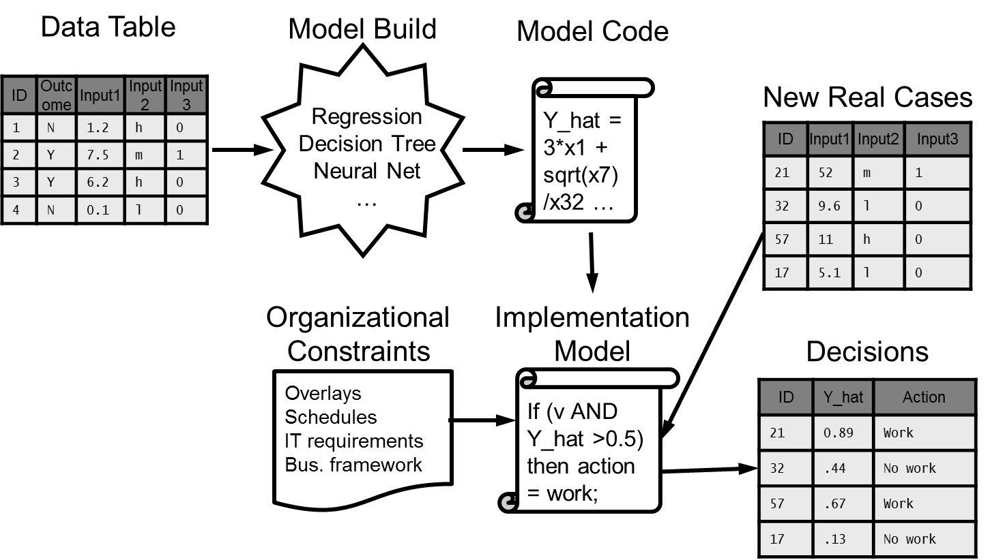
Data Structure for Data Mining
Inputs
Key ID
Target Outcome
Treatments
Covariates
Lab Available
1
0
1
1
0
Student ID | Grade | Instructor | Lab Available | Teaching Assistant | Overall GPA | Gender | Prereq. Grade
Sue B. | B | Hall | Y | Turley | 3.5 | F | A
Bryce | A | Smith | N | Ace | 3.2 | M | B
Jean | C | Hall | Y | Mary | 3.0 | M | C
Ann | B | Turner | Y | Mary | 3.8 | F | B
Bob | A | Hall | N | Turley | 3.3 | M | A
Grade
2
1
3
2
1
Instructor
1
2
1
3
1
Teaching Assistant
3
1
2
2
3
Gender
1
0
0
1
0
Prereq. Grade
1
2
3
2
1
Notes:
How do we represent each of the variables in the table?
What form is best for the model we will use?
How will preparation steps alter the outcome of our analytics?
Each data set and project is unique
DP techniques should be thought of as a toolset rather than a strict recipe
>>>>>>>>>>>>>>>>>>>>>>>>>>>>>>>>>>>>>>>>>>>>>>>>>>>>>>>>>>>>>>>>>>>>>>>>>>>>>>>>>>>>>>>>>>>>>>>>>>>
Narrative:
In the previous lesson, we saw how data is fed into the model building process, and how, as the starting point for model building, missteps in data understanding and data preparation can throw the entire analytics course off track.
This is easy to picture and grasp. However, figuring out how to put the data in the optimal form for use in modeling is not necessarily so transparent. For instance, take the table we used in the last lesson. It is pretty straightforward, right? We understand that each row represents a student and the columns represent attributes related to students’ academics. We see their instructors and teaching assistants are represented by the last names of those individuals. Grades and prerequisite grades are defined by the traditional letter grades A-F used in most academic settings. Furthermore, overall GPA is represented by a number with a single decimal value. Finally, gender and lab availability values each fall into one of two different categories: M or F for gender and Y or N for lab availability.
Based on this cursory assessment, we might say that our understanding of the data is pretty sound. It all makes sense, right? We even understand that we are trying to use this information to somehow figure out how to predict student grades. But, unfortunately, it is pretty tough to see exactly how to represent each of these variable values. Should we leave them all in their original forms? That might be more trouble than it is worth in the case of the text-based categorical variables. Or do we transform them all to numerical value based systems. We could represent grades from 1-5 with 1 being an A and 5 being an F. Instructors and teaching assistants could likewise be represented by integers representing the alphabetical ordering of their last names. Finally, lab availability and gender could be transformed into binary variables since each only has one of two possible outcomes.
These transformations might speed up the model execution by making calculations more efficient, but are these transformations really the most appropriate for our ultimate modeling goals? Will different kinds of preparation steps change the outcome of our analytics?
Furthermore, even if we know the answers to the questions for one data set, they make take on completely different forms and challenges in a different data set. We can expect deviations from project to project and from data set to data set, and therefore we can think of these data preparation activities as sets of possible techniques for preparing data. We can decide which we should and should not use on a case-by-case basis.

Slide 49
Key Components of Data Preparation
Business Understanding
Data Understanding
Modeling
Evaluation
Deployment
Data Preparation
Data Preparation
Select Data
Clean Data
Construct Data
Integrate Data
Format Data
Notes:
Selecting Data (Select; Integrate data) and Cleaning Single Variables from Problems (Clean; Format data)
Create new features from existing variables (Construct data)
Reduce candidate inputs by removing redundant and irrelevant variables and features (Clean data)
>>>>>>>>>>>>>>>>>>>>>>>>>>>>>>>>>>>>>>>>>>>>>>>>>>>>>>>>>>>>>>>>>>>>>>>>>>>>>>>>>>>>>>>>>>>>>>>>>>>
Narrative:
The process begins by collecting any additional data needed and dividing and separating the final raw data into testing/training groups or samples. Next, in cleaning the data, significance and correlation tests can be used to decide which fields and attributes should be excluded from use in modeling and to assign weights, when necessary, to those attributes included.
In constructing data, produced attributes may be derived from existing attributes; they may be newly created; or they may be transformed values from existing attributes. These new attributes may be included to highlight the relevant importance of certain attributes (as in weighting or weighted normalization) or they may be included to facilitate modeling execution and implementation.
Next, data integration covers merging, which combines multiple tables or records to create new records or values with different information about the same objects, and aggregations, which compute new values by summarizing information from multiple records and/or tables.
Finally, data formatting includes syntactic modifications that do not change the meaning of the data, but are often required by the modeling tool (i.e. reordering -> randomization, sorted by value, etc.)
>>>>>>>
Select Data
Rationale for Inclusion/Exclusion
Select a Holdout Sample
Clean Data
Construct Data
Integrate Data
Merged Data
Data Aggregations
Format Data

Slide 50
Data Sampling
Selected Data
Training
Sample
Validation
Sample
Testing
Sample
Notes:
Partition data after selecting all raw data
Training data for model building
Validation data for model testing and refinement
Testing data for model for estimating final predicted model performance after model completion
Training and validation sets used to build model and perform initial tests
Different data samples allow for refinements
(Example of preparing for an exam) after multiple times taking a practice test, do you really know the material or are you just memorizing test questions?
Solution = buy another book!
Training/testing data can inform model adjustments during refinement and lead to overfit that just improves performance on those data sets
Hold-out sample (testing sample) – prevents leaks from the future by setting it aside early in the process and not looking at it!
Final estimate of predicted model performance or accuracy once deployed (assesses predictability)
Makes sure you do not memorize data or model noise
Same performance on testing/training and validation samples = not overfit
Added benefit of reducing cases submitted to model during development leading to efficiency improvements
>>>>>>>>>>>>>>>>>>>>>>>>>>>>>>>>>>>>>>>>>>>>>>>>>>>>>>>>>>>>>>>>>>>>>>>>>>>>>>>>>>>>>>>>>>>>>>>>>>>
Narrative:
After the selection of the cumulative raw data set, it should be partitioned into distinct subsets, which include an initial training set, as well as a validation set that combine to allow for model construction and refinement. A final testing set is also formed to test final model performance and predictability. The process of model building hinges on the use of these data sets. Imagine you built a model on the entire raw data set. When you finished algorithm development and model construction, you would need to assess its performance and get some kind of measure of how good of a job you did! If you used the entire data to build the model, you would have to use this same data, or portions of it, to test the model. The problem with this approach is that the model was designed to classify these data inputs or predict a particular outcome based on input metric values; it knows exactly how to handle these points! So, your model will always behave in the same, wonderful way every time you test it with the same data that was used in its development.
How do we go about getting an accurate picture of the model’s value and performance? Since models can most often be built on only 10-20% of the data, a small training sample of the entire raw data set can be extracted to be used to build the model. Another, similar sized sample can then be extracted from the remaining raw data set to serve as a validation sample that can be used to assess model performance after its initial construction. Modelers can then use assessment outputs to change settings, parameters or inputs to the model in attempts to refine its predictability. Afterwards, the model can be rebuilt on the same initial training data sample, reassessed on the same validation sample and refined again as needed.
After modelers become satisfied with refined model performance, it is important to determine whether the model is actually behaving well or if it just memorized the training and validation data. It is possible that testing data becomes a driver for how the algorithm builds the model by informing the modeler or software on how to adjust the modeling algorithm parameters so that model performance on testing data is improved. A good example of this can be seen in student preparations for exams. Students may go through several cycles of taking a practice test, assessing their performance and determining what they need improvement on, and retaking the practice test. After several iterations, scores are likely to increase. However, after a certain point the question must be asked: do you really know the material or are you just memorizing test questions? What is the solution to this problem? Simple! Buy another test booklet and see how your performance on new questions compares to the old questions!
The same approach applies to sampling in data science, data that was not used in the training or validation samples can be used in a final testing sample. This sample is often referred to as a hold-out sample because it is set aside at this early stage in the CRISP-DM process so that it does not influence modelers’ decisions or approaches, thus helping to prevent leaks from the future. Using this testing sample will allow for a final estimate to be made of model accuracy, performance and predictability upon deployment. Observing similar performance on training/validation and testing samples will indicate that we have successfully avoided model overfit and that we have not simply memorized sample data or inadvertently modeled noise in the data.
Finally, data sampling has another unique benefit to model development. As we stated earlier, typically only a small percentage of the raw data is required for model development and/or testing. By only using one of these sets at a time when building the model, you are effectively reducing the number of data cases submitted to the modeling algorithm. This allows for drastic efficiency improvements in development, decreasing computational requirements and time spent waiting on a model run to complete.

Slide 51

Data Preparation: Clean Data
Deal with redundant, obsolete and trivial data (ROT)
Filtering on a column
Filtering out a column
Deal with special values
EX: Default values of 99 for unknown data
Value truncation
Deal with noise
Understanding and
handling outliers
Estimate missing values
responsys.com
Notes:
Cleaning data
Dealing with ROT
Filtering on a column
Filtering out a column
Dealing with special values
EX: surveys fill missing entries with 99
EX: values like 100 and 100,000 truncated to 00
Dealing with noise
Understanding and handling outliers
Estimating missing values (imputation)
>>>>>>>>>>>>>>>>>>>>>>>>>>>>>>>>>>>>>>>>>>>>>>>>>>>>>>>>>>>>>>>>>>>>>>>>>>>>>>>>>>>>>>>>>>>>>>>>>>>
Narrative:
One thing that is important to understand in data preparation is that database cleanliness is not the same as predictive modeling cleanliness. As such, the overall quality level must be raised to that required by the selected analysis techniques. A number of actions can be taken to address quality problems and their possible impacts on the analysis results.
Examples of cleaning actions begin with removing obvious junk from our sources. Specifically, this includes redundant, obsolete and trivial data (or ROT). We will filter out invalid or bad data, eliminate data that is too detailed and further confirm that all contents in the gathered data are valid entries for each variable, which is often a good check for human error. Some software has built-in tools that allow you to find these values and filter to replace or eliminate. It also might be valuable to delete variables with values (or blanks) that are inappropriate for the data set or the selected modeling technique. Inclusion of these values could confuse the signal fed to the model and hamper its predictability. An example of dealing with ROT may be users wanting to reduce the use of data that is overly detailed for the needs of the model. Time-series data variability and its associated noise may be reduced by applying filters similar to those used in signal processing.
Modelers will take this time to deal with special values in the raw data. They will determine the meanings of default values (i.e. 9999), implications of unknown data and the possibility and effects of any truncated values. For example, some surveys fill missing entries with default values like 99. In other cases, values such as 100 and 100,000 might be truncated to 00. Appropriate actions must be taken to replace these values with appropriate representatives.
Furthermore, we will want to figure out how to handle noise, deal with outliers and estimate missing values appropriately.
Finally, cleaning involves selecting clean subsets if not already completed or if we need to further split up or reduce sample sizes.
Image from:
https://www.responsys.com/blogs/nsm/cross-channel-marketing/spring-cleanup-bad-data-not-big-data-needs-your-attention/

Slide 52
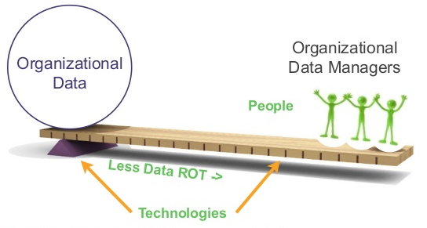
Clean Data: ROT
Leverage - exploit advantages to
gain returns on assets
Eliminate Redundant, Obsolete and Trivial Data!
Filter ON a column vs. filtering OUT a column
The bigger the organization, the greater the potential leverage that exists through elimination of ROT!
The Case for the Chief Data Officer: Recasting the C-Suite to Leverage Your Most Valuable Asset (Peter Aiken and Michael Gorman)
Notes:
Reducing ROT; Data Leverage
Organizational data can be unmanageable
Too much data -> wasted productivity (80% is ROT)
Underutilized data -> poor leveraged organizational resources
Exploit advantages to gain returns on asset (organizational data)
Data-centric technologies, process and human skill sets help
Elimination of ROT, however, can increase leverage!
Determine what is important and what is not important (business understanding)
Make a clean analytic data set out of a record keeping data set
Eliminate information that is too detailed
transactional data; workflow/event data; master & reference data; reporting & analytical data; metadata
EX: Redundant – often address information is redundant (already have zip code which is all that is needed)
EX: Trivial – hair color, eye color (just need gender)
Permits better data management
Must invest in treating data like assets and reducing ROT to see returns in the form of improved productivity and reduced costs
Productivity: use same facts, structures and databases over and over (avoids confusion with multiple sources)
Cost: prevents duplicate work and lowers IT costs
The bigger the organization, the greater potential leverage exists through elimination of ROT
>>>>>>>>>>>>>>>>>>>>>>>>>>>>>>>>>>>>>>>>>>>>>>>>>>>>>>>>>>>>>>>>>>>>>>>>>>>>>>>>>>>>>>>>>>>>>>>>>>>
Narrative:
Many organizations, especially large ones, have incredible stores of data that must be managed carefully as like critical business assets. Unfortunately, the combination of the large size of many of these data stores and the fact that 80% of typical organizational data is redundant, obsolete or trivial (ROT), can make it incredibly hard to appropriately capitalize on data. Too much data can lead to wasted productivity and underutilized data can lead to poorly leveraged resources.
Fortunately, data scientists can employ the engineering concept of leverage to better work with such organizational data. In business terms, implementing leverage means exploiting an advantage to gain a return on an asset such as staff, product, sales or inventory. In data science, we can gain leverage for gaining returns on organizational data by using helpful data-centric technologies, processes and human skill sets. These can take the form of software like SAS Enterprise Miner, techniques like CRISP-DM and tapping into subject matter experts for advice on analytics. However, our real advantage and potential for increasing leverage comes from reducing or eliminating ROT. By tapping into our understanding of business needs, we can determine what pieces of our raw data are important and what are not. The long term success of ROT elimination and its impacts on increasing leverage require dedicated resources and organizational commitment along with specialized knowledge, but if it is practiced diligently, investments in ROT reduction can lead to returns on work with organizational data like lowered IT costs and increased productivity. This is especially important in larger companies, as the bigger the organization, the greater potential for leverage exists!
Sources:
http://www.slideshare.net/aberkowitz/2013-monetizing-final
http://www.slideshare.net/aberkowitz/dataed-datacentric-strategy-roadmap
The Case for the Chief Data Officer: Recasting the C-Suite to Leverage Your Most Valuable Asset (Peter Aiken and Michael Gorman)

Slide 53
Clean Data
Inputs
Key ID
Target Outcome
Treatments
Covariates
Student ID | Grade | Instructor | Lab Available | Teaching Assistant | Overall GPA | Gender | Prereq. Grade
Sue B. | B | Hall | Y | Turley | 3.5 | Female | A
Bryce | 001 | Smith | N | Ace | 3.2 | M | B
Jean | C | Hall | Yes | Mary | 3.0 | M | C
Ann | B | 99999999 | Y | Mary | 38 | F | B
Bob | A | Hall | N | Turley | 3.3 | M | A
Student ID | Grade | Instructor | Lab Available | Teaching Assistant | Overall GPA | Gender | Prereq. Grade
Sue B. | B | Hall | Y | Turley | 3.5 | Female | A
Bryce | 001 | Smith | N | Ace | 3.2 | M | B
Jean | C | Hall | Yes | Mary | 3.0 | M | C
Ann | B | 99999999 | Y | Mary | 38 | F | B
Bob | A | Hall | N | Turley | 3.3 | M | A
Student ID | Grade | Instructor | Lab Available | Teaching Assistant | Overall GPA | Gender | Prereq. Grade
Sue B. | B | Hall | Y | Turley | 3.5 | Female | A
Bryce | 001 | Smith | N | Ace | 3.2 | M | B
Jean | C | Hall | Yes | Mary | 3.0 | M | C
Ann | B | 99999999 | Y | Mary | 38 | F | B
Bob | A | Hall | N | Turley | 3.3 | M | A
Student ID | Grade | Instructor | Lab Available | Teaching Assistant | Overall GPA | Gender | Prereq. Grade
Sue B. | B | Hall | Y | Turley | 3.5 | Female | A
Bryce | 001 | Smith | N | Ace | 3.2 | M | B
Jean | C | Hall | Yes | Mary | 3.0 | M | C
Ann | B | 99999999 | Y | Mary | 38 | F | B
Bob | A | Hall | N | Turley | 3.3 | M | A
Student ID | Grade | Instructor | Lab Available | Teaching Assistant | Overall GPA | Gender | Prereq. Grade
Sue B. | B | Hall | Y | Turley | 3.5 | Female | A
Bryce | 001 | Smith | N | Ace | 3.2 | M | B
Jean | C | Hall | Yes | Mary | 3.0 | M | C
Ann | B | 99999999 | Y | Mary | 38 | F | B
Bob | A | Hall | N | Turley | 3.3 | M | A
Student ID | Grade | Instructor | Lab Available | Teaching Assistant | Overall GPA | Gender | Prereq. Grade
Sue B. | B | Hall | Y | Turley | 3.5 | Female | A
Bryce | 001 | Smith | N | Ace | 3.2 | M | B
Jean | C | Hall | Yes | Mary | 3.0 | M | C
Ann | B | 99999999 | Y | Mary | 38 | F | B
Bob | A | Hall | N | Turley | 3.3 | M | A
Invalid or bad data present?
Improper default values present?
Value truncation needed?
Notes:
Dealing with special values, truncations, incorrect values or other “bad” data
Look for improper default values
Look for inconsistencies in truncation in text values
Look for spikes in distribution or obvious outliers (may indicate decimal place error if outside of scale – i.e. GPA)
Examples:
- date format mm/dd/yyyy or dd/mm/yyyy or DD Month Year, etc.
- Categorical variables like zip code form (string or integer?)
>>>>>>>>>>>>>>>>>>>>>>>>>>>>>>>>>>>>>>>>>>>>>>>>>>>>>>>>>>>>>>>>>>>>>>>>>>>>>>>>>>>>>>>>>>>>>>>>>>>
Narrative:
Here we can see an example of what we mean when we do initial cleaning by finding and fixing special values, values that need to be truncated or have been prematurely truncated, incorrect values, or other obvious incongruences that could be labeled as bad data.
Some values may require SMEs to interpret the values so the analyst better understands the intent of the values to uncover how and why the incorrect values made their way into the data in the first place. If values cannot be interpreted they should be treated as missing if they are infrequent, but left as the incorrect value if frequent for later interpretation. However, in many cases, simple inspection will allow us to pick out obvious errors that can be corrected. Here we can identify values in the variables that occur infrequently and are unusual.
Inspection for continuous variables can follow a similar process. Suspicious continuous data can also be easily spotted as outliers or unusual values or as spikes in the distribution (i.e. the 38 in the GPA in the table above or a single value repeated far more often like a 1 or 0 in a distribution). If these suspicious values are so infrequent that they cannot be detected easily, they will often be irrelevant in the modeling process and can be (often) safely removed from further consideration. This, however, should always be done with caution.

Slide 54
Clean Data: Missing Values
Missing Value Representation | Description
Null, empty string (“ “) | Numeric / categorical variables
0 | Numeric variables never equal to 0
-1 | Numeric variables that are never negative
99, 999, and so on | Numeric variables with values less than 10, 100 and so on
-99, -999, and so on | Numeric variables that can be negative
U, UU | Categorical variables (1 or 2 character codes especially)
00000, 00000-0000, XXXXX | ZIP codes
11/11/11 | Dates
000-000-0000, 0000000000 | Phone numbers
Applied Predictive Analytics: Principles and Techniques for the Professional Data Analyst (Dean Abbott)
Notes:
Missing Values:
Some due to entry errors; some unknown
Could have been lost or never collected in the first place
Could have been deliberately withheld
Missing data also encompasses outcomes for audited parties not listed
EX: tax collection agencies and marketing organizations may only list targets (all other individuals may be “missing”)
Sometimes hard to spot!
EX: Gender of Head of Household = M, F, J (joint) or D (did not respond) – looks like a real entry
EX: Income codes 1-9; 0 is missing even though it looks like a possible value
>>>>>>>>>>>>>>>>>>>>>>>>>>>>>>>>>>>>>>>>>>>>>>>>>>>>>>>>>>>>>>>>>>>>>>>>>>>>>>>>>>>>>>>>>>>>>>>>>>>
Narrative:
It is far too commonplace to have missing values in data. The reasons for these missing values can be incredibly varied. Some may have been lost due to data corruption or overwriting of database tables. Other may be missing because it was never collected in the first place because of collection limitations or forgetfulness. Finally, some data may be missing because it was deliberately withheld during collection (i.e. surveys and questionnaires).
It is important to note that some missing values are due to simple data entry errors, while others are just unknown values. Examples of these unknown values include outcomes for audited parties not listed in reports – often because they were not included in assessments and evaluations (i.e. tax collection agencies; marketing organizations). These cases are particularly interesting, as just the fact that they are missing might provide predictive information about their properties and their differences from cases included.
Of course missing data may take the straightforward form of blanks where values would otherwise be located, but it can also take many other forms. It is important to carefully go over your data to know what this might look like in different attributes. The table above shows many examples of missing data forms. One example is values for a Head of Household variable. Acceptable values may include male (M), female (F) or joint (J). Missing values are represented as did not respond (D), which may look like an actual entry and can get overlooked without careful attention! In another example, income codes representing different levels of income brackets may range from 1 to 9. Missing values are represented as 0, which looks like the actual integer values. However, it must be treated separately since it is a missing value and not an actual income bracket.

Slide 55
Clean Data: Missing Values
Contract ID | Contract Value ($) | Contract Length (months) | Number of Contractors Needed | State | Subcontractor
XX-XXX-A04 | 1,400,000 | 15 | 3 | IL | Yes
XX-XXX-A12 | 2,000,000 | 18 | 4 | IL | Yes
XX-XXX-D07 | 500,000 | 6 | 1 | TX | No
XX-XXX-D08 | 750,000 | 12 | 2 | OR | Yes
XX-XXX-D10 | 10,000,000 | 36 | 4 | NY | No
XX-XXX-F01 | 200,000 | 6 | 6 | VA | No
XX-XXX-G04 | 1,000,000 | 12 | 2 | DC | No
XX-XXX-G11 | 1,200,000 | 9 | 5 | VA | Yes
XX-XXX-H22 | 950,000 | 15 | 3 | MD | Yes
XX-XXX-M01 | 425,000 | 6 | 2 | NY | Yes
XX-XXX-R38 | 1,100,000 | 24 | 4 | CA | Yes
XX-XXX-AA1 | 800,000 | 24 | 2 | IL | No
Mean | 1,693,750 | 15 | 3
Contract ID | Contract Value ($) | Contract Length (months) | Number of Contractors Needed | State | Subcontractor
XX-XXX-A04 | 1,400,000 | 15 | 3 | IL | Yes
XX-XXX-A12 | 2,000,000 | 18 | 4 | IL | Yes
XX-XXX-D07 | 500,000 | 6 | 1 | TX | No
XX-XXX-D08 | 750,000 | 12 | 2 | OR | Yes
XX-XXX-D10 | 10,000,000 | 36 | 4 | NY | No
XX-XXX-F01 | 200,000 | 6 | 6 | VA | No
XX-XXX-G04 | 1,000,000 | 12 | 2 | DC | No
XX-XXX-G11 | 1,200,000 | 9 | 5 | VA | Yes
XX-XXX-H22 | 950,000 | 15 | 3 | MD | Yes
XX-XXX-M01 | 425,000 | 6 | 2 | NY | Yes
XX-XXX-R38 | 1,100,000 | 24 | 4 | CA | Yes
XX-XXX-AA1 | 800,000 | 24 | 2 | IL | No
Mean | 1,693,750 938,636 | 15 | 3
Contract ID | Contract Value ($) | Contract Length (months) | Number of Contractors Needed | State | Subcontractor
XX-XXX-A04 | 1,400,000 | 15 | 3 | IL | Yes
XX-XXX-A12 | 2,000,000 | 18 | 4 | IL | Yes
XX-XXX-D07 | 500,000 | 6 | 1 | TX | No
XX-XXX-D08 | 750,000 | 12 | 2 | OR | Yes
XX-XXX-D10 | 10,000,000 | 36 | 4 | NY | No
XX-XXX-F01 | 200,000 | 6 | 6 | VA | No
XX-XXX-G04 | 1,000,000 | 12 | 2 | DC | No
XX-XXX-G11 | 1,200,000 | 9 | 5 | VA | Yes
XX-XXX-H22 | 950,000 | 15 | 3 | MD | Yes
XX-XXX-M01 | 425,000 | 6 | 2 | NY | Yes
XX-XXX-R38 | 1,100,000 | 24 | 4 | CA | Yes
XX-XXX-AA1 | 800,000 | 24 | 2 | IL | No
Mean | 1,693,750 938,636 | 15 12 | 3
Contract ID | Contract Value ($) | Contract Length (months) | Number of Contractors Needed | State | Subcontractor
XX-XXX-A04 | 1,400,000 | 15 | 3 | IL | Yes
XX-XXX-A12 | 2,000,000 | 18 | 4 | IL | Yes
XX-XXX-D07 | 500,000 | 6 | 1 | TX | No
XX-XXX-D08 | 750,000 | 12 | 2 | OR | Yes
XX-XXX-D10 | 10,000,000 | 36 | 4 | NY | No
XX-XXX-F01 | 200,000 | 6 | 6 | VA | No
XX-XXX-G04 | 1,000,000 | 12 | 2 | DC | No
XX-XXX-G11 | 1,200,000 | 9 | 5 | VA | Yes
XX-XXX-H22 | 950,000 | 15 | 3 | MD | Yes
XX-XXX-M01 | 425,000 | 6 | 2 | NY | Yes
XX-XXX-R38 | 1,100,000 | 24 | 4 | CA | Yes
XX-XXX-AA1 | 800,000 | 24 | 2 | IL | No
Mean | 1,693,750 938,636 | 15 12 | 3 4
Contract ID | Contract Value ($) | Contract Length (months) | Number of Contractors Needed | State | Subcontractor
XX-XXX-A04 | 1,400,000 | 15 | 3 | IL | Yes
XX-XXX-A12 | 2,000,000 | 18 | 4 | IL | Yes
XX-XXX-D07 | 500,000 | 6 | 1 | TX | No
XX-XXX-D08 | 750,000 | 12 | 2 | OR | Yes
XX-XXX-D10 | 10,000,000 | 36 | 4 | NY | No
XX-XXX-F01 | 200,000 | 6 | 6 | VA | No
XX-XXX-G04 | 1,000,000 | 12 | 2 | DC | No
XX-XXX-G11 | 1,200,000 | 9 | 5 | VA | Yes
XX-XXX-H22 | 950,000 | 15 | 3 | MD | Yes
XX-XXX-M01 | 425,000 | 6 | 2 | NY | Yes
XX-XXX-R38 | 1,100,000 | 24 | 4 | CA | Yes
XX-XXX-AA1 | 800,000 | 24 | 2 | IL | No
Mean | 1,693,750 938,636 | 15 12 | 3 4
Contract ID | Contract Value ($) | Contract Length (months) | Number of Contractors Needed | State | Subcontractor
XX-XXX-A04 | 1,400,000 | 15 | 3 | IL | Yes
XX-XXX-A12 | 2,000,000 | 18 | 4 | IL | Yes
XX-XXX-D07 | 500,000 | 6 | 1 | TX | No
XX-XXX-D08 | 750,000 | 12 | 2 | OR | Yes
XX-XXX-D10 | 10,000,000 | 36 | 4 | NY | No
XX-XXX-F01 | 200,000 | 6 | 6 | VA | No
XX-XXX-G04 | 1,000,000 | 12 | 2 | DC | No
XX-XXX-G11 | 1,200,000 | 9 | 5 | VA | Yes
XX-XXX-H22 | 950,000 | 15 | 3 | MD | Yes
XX-XXX-M01 | 425,000 | 6 | 2 | NY | Yes
XX-XXX-R38 | 1,100,000 | 24 | 4 | CA | Yes
XX-XXX-AA1 | 800,000 | 24 | 2 | IL | No
Mean | 1,693,750 938,636 | 15 12 | 3 4
Notes:
Dealing with missing values must be done with care!
Missing values (and their replacements) can have a huge impact on data and its descriptive statistics
Do missing values create problems or are they insignificant?
>>>>>>>>>>>>>>>>>>>>>>>>>>>>>>>>>>>>>>>>>>>>>>>>>>>>>>>>>>>>>>>>>>>>>>>>>>>>>>>>>>>>>>>>>>>>>>>>>>>
Narrative:
Data cleaning will also include processes for dealing with missing values. This is incredibly important as missing values can have huge impacts on the data as a whole and on dependent analyses. We want to characterize the nature of our missing values and determine if their existence creates problems that must be dealt with or if they are relatively insignificant.
In this example, we can see that missing values can really affect mean values. This can have lots of different impacts on analyses, such as significantly altering data normalization efforts. Therefore, we probably want to deal with these values in some way.
Missing data in the State and Subcontractor columns might not appear to have as much of an impact. However, if we look at the State column, we see that a missing value for DC means that we no longer have DC represented in our data set! This could be a huge problem if we are trying to predict something for that city…or if those values are attributed to or lumped in with another city! So, we should figure out how to deal with this, too.

Slide 56
Clean Data: Outliers
I |  | II |  | III |  | IV
x | y | x | y | x | y | x | y
10.0 | 8.04 | 10.0 | 9.14 | 10.0 | 7.46 | 8.0 | 6.58
8.0 | 6.95 | 8.0 | 8.14 | 8.0 | 6.77 | 8.0 | 5.76
13.0 | 7.58 | 13.0 | 8.74 | 13.0 | 12.74 | 8.0 | 7.71
9.0 | 8.81 | 9.0 | 8.77 | 9.0 | 7.11 | 8.0 | 8.84
11.0 | 8.33 | 11.0 | 9.26 | 11.0 | 7.81 | 8.0 | 8.47
14.0 | 9.96 | 14.0 | 8.10 | 14.0 | 8.84 | 8.0 | 7.04
6.0 | 7.24 | 6.0 | 6.13 | 6.0 | 6.08 | 8.0 | 5.25
4.0 | 4.26 | 4.0 | 3.10 | 4.0 | 5.39 | 19.0 | 12.50
12.0 | 10.84 | 12.0 | 9.13 | 12.0 | 8.15 | 8.0 | 5.56
7.0 | 4.82 | 7.0 | 7.26 | 7.0 | 6.42 | 8.0 | 7.91
5.0 | 5.68 | 5.0 | 4.74 | 5.0 | 5.73 | 8.0 | 6.89
Anscombe’s Quartet
Demonstrates importance of data visualization
Helps us identify outliers
Property | Value
Mean of x in each case | 9 (exact)
Variance of x in each case | 11 (exact)
Mean of y in each case | 7.50 (to 2 decimal places)
Variance of y in each case | 4.122 or 4.127 (to 3 decimal places)
Correlation between x and y in each case | 0.816 (to 3 decimal places)
Linear regression line in each case | y = 3.00 + 0.500x
Notes:
Anscombe’s Quartet
Four data sets each consisting of eleven x,y points that have nearly identical simple statistical properties
Are they really similar?
Graph them to be sure!
>>>>>>>>>>>>>>>>>>>>>>>>>>>>>>>>>>>>>>>>>>>>>>>>>>>>>>>>>>>>>>>>>>>>>>>>>>>>>>>>>>>>>>>>>>>>>>>>>>>
Narrative:
Sometimes, our descriptive statistics may not reveal anything novel about our data. Everything may seem fine and fairly normal, when in reality something interesting may be going on. Anscombe’s quartet demonstrates this principle well. In the data sample you see above, each of the four distributions have similar descriptive statistics in the table on the bottom. They can even all be fit with the same linear regression line with the same correlation coefficient.
What does this data look like when we plot it though?

Slide 57
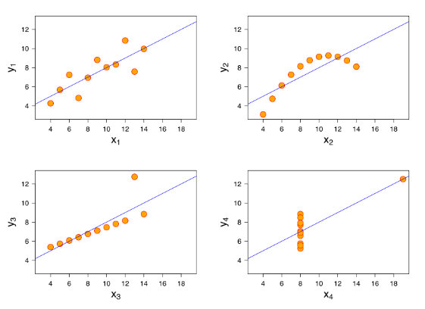
Clean Data: Outliers
Important to graph data before analyzing it according to a particular type of relationship!
Residuals with respect to linear regression line
Notes:
Anscombe’s Quartet
Appear very different when graphed!!
Scatter 1: simple linear relationship (following assumption of normality)
Scatter 2: not distributed normally; relationship between two variables (non-linear); Pearson correlation coefficient is not relevant; quadratic structure
Scatter 3: linear distribution, but with a different regression line (offset by one outlier exerting influence to alter regression and lower correlation coefficient from 1 to 0.816); removal of the outlier results in a trend linear with a near perfect linear fit
Scatter 4: one outlier is enough to produce high correlation coefficient, even thought the relationship between the two variables is not linear
* Leverage point – extreme outlier; extreme distance from general trend of the data causes the regression line to pass through or near the data point
Demonstrates the importance of graphing data before analyzing it according to a particular type of relationship
Demonstrates inadequacies of basic statistic properties for describing real data sets
Demonstrates the effect of outliers on statistical properties
Handling outliers:
Remove them
Separate them and create separate models for them
EX: Fraud detection – want to understand why this is happening and what the outlier represents
Transform so that they are no longer outliers through standardization and normalization methods
Bin the data (outlier bin)
Leave them in the data without modification.
>>>>>>>>>>>>>>>>>>>>>>>>>>>>>>>>>>>>>>>>>>>>>>>>>>>>>>>>>>>>>>>>>>>>>>>>>>>>>>>>>>>>>>>>>>>>>>>>>>>
Narrative:
As we can see here, the samples look incredibly different when graphed! Plotting the residuals vs. the fitted values gives us additional information about the fit of the model in each of the data sets. Scatter 1 is a good fit because the scatter plot looks like noise. The other plots show patterns in the residuals, indicating that a linear relationship model is not appropriate for the data.
We can then ask ourselves, why might the linear model given not be ideal? In the second plot, we can clearly see that the data has a quadratic structure. Therefore, a corresponding quadratic relationship model would be more appropriate. However, in Scatter 3 and 4, the situation is a bit more interesting. In each of these scenarios, singular outlier points offset the regression lines. In Scatter 3, the regression line is only slightly offset from the linear pattern of the majority of the data, and removal of the singular outlier would result in a trendline with near perfect linear fit. In Scatter 4, the singular outlier is significant enough that it is causing a high correlation coefficient and the regression line to pass through it even though the relationship between the two variables is not linear.
So, if we see something interesting like this in our graphs how do we know if there is an outlier. And how do we know what exactly an outlier is for that matter?
Technically, an outlier is any unusual or suspect point that is far away from the rest of the data. Anscomble gave an example to illustrate this definition further. He described a study on education, where he studied per-capita expenditures for public schools in the 50 U.S. states and the District of Columbia. Alaska is a bit of an outlier, so it moves the regression line away from the mainstream. However, if Alasksa is removed before computing the regression, another state will become an outlier. Repeating this cycle may continually reveal “new” outliers. How, then, do we know when to stop?
Anscombe argues that the correct answer is to show both the regression with Alaska, but also how much it contributes and what happens when it is removed. The actual data, residuals and other data can then be used to judge how well the model fits and when to stop removing outliers.
In determining which outliers to remove and which to keep, you will likely consider whether or not those outliers are leverage points. Leverage is a quantitative description of how far a point is from the rest of the points in the x-direction and measures how influential a point has the potential to be with respect to the regression line. Moving a point with more leverage will have a greater probability of having a larger effect on the slope of the regression line. Outliers with the highest leverage, also know as influential points, should be carefully inspected because they can have the largest influence on the model (good or bad) and thus how they are handled is very important.
However, with a thorough understand of the outliers in your data and what they mean, you can begin take actions to remove them or mitigate their influence on others.
We can remove outliers. This is risky for many reasons. For example, removing records associated with egregious fraud or with very best customer lifetime value from a data set can be beneficial when trying to model average or regular cases, but can be incredibly detriment when attempting to create a model to identify a subset of customer behavior that is particularly good or particularly bad.
We can separate outliers and create separate models for them. This is beneficial in that it enables you to overcome the problem of deploying models that did not have outliers in the training data. You can essentially create an ensemble where the overarching model is a decision trees that splits the data into the two model categories.
We can transform outliers so they are no longer outliers through standardization and normalization methods.
We can bin the data by first creating a single-column dummy variable to indicate that the variable is an outlier and then transforming outliers to this bin value to mitigate numeric affect of outlier on numeric algorithms.
We can leave the outliers in the data without modification.
If we tap into our business and data understanding, we will know that some outliers are extremes, some are data coded incorrectly, some are not extremes (i.e. profits less than 100 that occur very infrequently); may not be detected in anything other than visualization, but can cause algorithms to behave in unexpected ways (no numerical bias). We must use this knowledge carefully so that we can know how outliers play into our model and mitigate outliers appropriately.

Slide 58
Construct Data: Data Transformation
Numerical Variables
Linearization
Notes:
Constructing data by transforming existing variable data:
EX: transforming variables with exponential relatioships to linear data for use in parametric statistical modeling algorithms (LINEARIZATION)
>>>>>>>>>>>>>>>>>>>>>>>>>>>>>>>>>>>>>>>>>>>>>>>>>>>>>>>>>>>>>>>>>>>>>>>>>>>>>>>>>>>>>>>>>>>>>>>>>>>
Narrative:
Many statistical routines assume each variable’s effects on the target to be linear. When this assumption does not hold and variables form exponential curves, but the user still wants to implement parametric statistical modeling algorithms, these variables must be transformed to be linear.

Slide 59
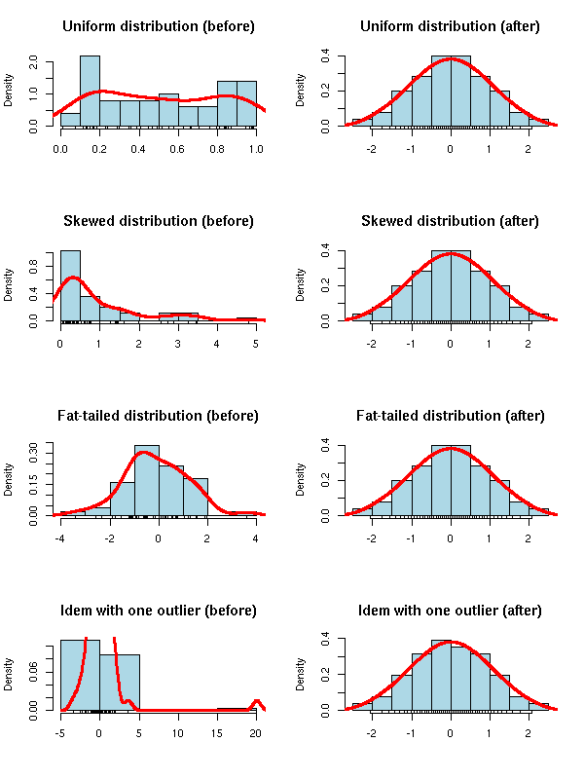
Construct Data: Data Transformation
zoonek2.free.fr
Notes:
Constructing data by transforming existing variable data:
Problem example: data that has positive skew, linear regression-nearest neighbor, K-Means will produce models with bias because of the positive tail of the distribution
Normalization methods that can help:
Correcting positive skew: log transform, multiplicative inverse, square root (reduce larger values more and reduce smaller values less)
Correcting negative skew: power transformation (scale by magnitude first)
>>>>>>>>>>>>>>>>>>>>>>>>>>>>>>>>>>>>>>>>>>>>>>>>>>>>>>>>>>>>>>>>>>>>>>>>>>>>>>>>>>>>>>>>>>>>>>>>>>>
Narrative:
As an example of the bias that can occur with raw data, data that has positive skew, linear regression-nearest neighbor, K-Means will produce models with bias because of the positive tail of the distribution (coefficient and influence of variables are more sensitive to the tails of the skewed distribution than one would find if the data were normally distributed).
Normalization and standardization activities thankfully can help us correct such problems. You can see above how standardization (z-scores shifting mean to 0 and SD to 1) transforms value distributions to the normal distribution. Other methods can be used in a similar fashion to make data more amenable to modeling. To correct positively-skewed data, log transform, multiplicative inverse, and square root transformations are often most helpful. On the other hand, to correct negative skew, power transformation is typically the transformation method of choice.
Images from:
http://zoonek2.free.fr/UNIX/48_R/03.html
http://www.mathsisfun.com/data/standard-normal-distribution.html

Slide 60
Construct Data: Data Transformation
Dummy Variables
CAR ID | SILVER | ORANGE | RED | BLACK
Car 1 | 1 | 0 | 0 | 0
Car 2 | 0 | 1 | 0 | 0
Car 3 | 0 | 0 | 1 | 0
Car 4 | 0 | 0 | 0 | 1
CAR ID | COLOR
Car 1 | Silver
Car 2 | Orange
Car 3 | Red
Car 4 | Black
Notes:
Dummy variables: reformatting data as numeric data
Reflect presence or absence of a particular categorical code in a variable
Each categorical code now has its own variable
Downside: each created dummy variable results in the loss of 1 degree of freedom; this leads to a greater potential for overfit
>>>>>>>>>>>>>>>>>>>>>>>>>>>>>>>>>>>>>>>>>>>>>>>>>>>>>>>>>>>>>>>>>>>>>>>>>>>>>>>>>>>>>>>>>>>>>>>>>>>
Narrative:
Transformation also includes reformatting discrete data represented by textual categories as numerical data for use in some modeling algorithms (like regression and neural nets). This process may require dummy variables (binary variable (1 or 0) to reflect presence or absence of a particular categorical code in a given variable). For example, if you were trying to use the color of a car as a model input variable, you could create dummy variables representing each possible color and for each car assign a value of 1 to the dummy variable representing the car’s color and 0 to all other dummy variables representing other possible colors.
While this is helpful in using categorical variables in models, each dummy variable used induces the loss of 1 degree of freedom, which can lead to a greater tendency for overfitting and a reduction in the generality of the model. As a result, while it may be necessary to create dummy variables for variables representing actual categories, recoding categorical variables that represent underlying numerical progressions (i.e. days of the week…as related to stress building up during the week) as sequential numbers might help prevent this loss of generality.
Images from:
http://www.mathsisfun.com/data/standard-normal-distribution.html
>>>>>>>>>>>>>>>>>>>>>>>>>>>>>>>>>>>>>>
Ordinal variables (p. 109)
Thermometer scale – modeling algorithms can incorporate education levels already achieved in the models (master’s or PhD also have a bachelor’s degree)
If bs are predictive, including individuals with master’s degrees or PhDs will strengthen the pattern associated with bachelor’s degrees
Include p. 111 diagram to show difference in selection based on graph at hand
- Empirical determination can be used, but can be very time consuming if not automated by software or scripted by the modeler

Slide 61
Construct Data: Weighting
A
B
C
D
E
F
Variables
Weighting
x2
x0.95
x0.25
x1.25
x0.667
x0.75
A
B
D
E
Variables
F
C
Notes:
Transformation through attribute weighting:
Reflects difference in importance in various attribute variables
Allows model to process relationships in a manner consistent with reality (sometimes variables should not all be treated equally)
>>>>>>>>>>>>>>>>>>>>>>>>>>>>>>>>>>>>>>>>>>>>>>>>>>>>>>>>>>>>>>>>>>>>>>>>>>>>>>>>>>>>>>>>>>>>>>>>>>>
Narrative:
Sometimes, the values of the variables in the compiled and cleaned data set still need to be adjusted through weighting and balancing. If one or more attributes are more important than others (based on context or variable analysis), it may be necessary to adjust these values accordingly. This allows the model to see and process relationships within the data in a manner that is consistent with reality, rather than treating all variables as equally contributing factors in predicting the target.

Slide 62
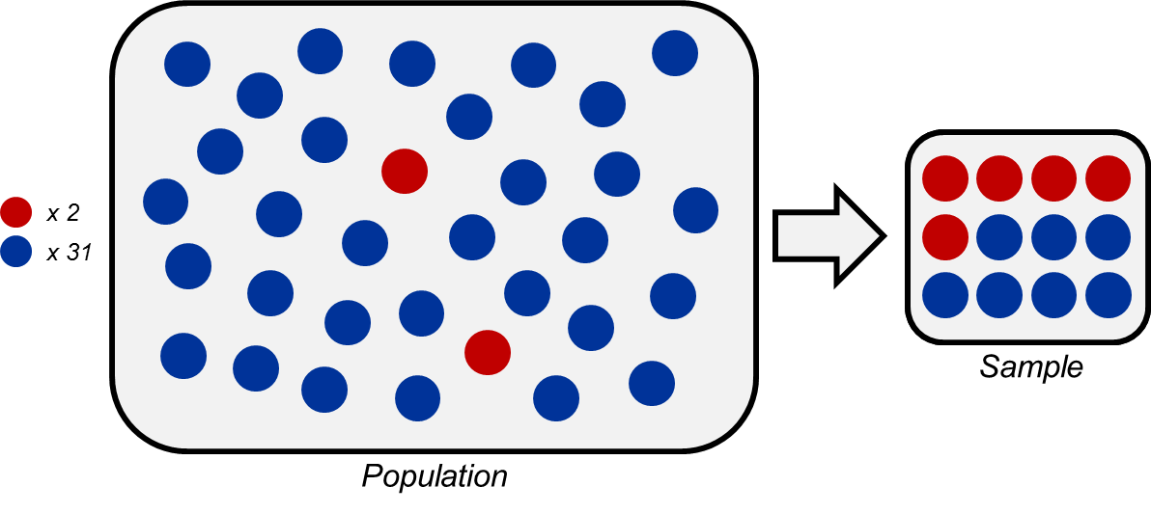
Construct Data: Balancing
x 0.05
Rare Cases
Normal Data
Normal Data
Rare Cases
x 0.95
Notes:
Transformation through balancing:
Applying heavier weights to rare cases allows algorithm to be affected differently by patterns in these rare cases
Patterns in rare cases affect the same as common cases (instead of being dwarfed by common cases)
Special type of weighting known as BALANCING
May be accomplished through heavier sampling of rare cases vs common cases when sampling
>>>>>>>>>>>>>>>>>>>>>>>>>>>>>>>>>>>>>>>>>>>>>>>>>>>>>>>>>>>>>>>>>>>>>>>>>>>>>>>>>>>>>>>>>>>>>>>>>>>
Narrative:
Weighting is incredibly important when using models to detect rare cases. Applying heavier weights to these rare cases allows the algorithm to be affected differently by the patterns in rare cases versus common cases. Without this weighting, both normal data and rare cases have the same potential effect on adjusting the weights. Weighting of rare cases can be accomplished by thinking of the weight as if it were a frequency applied for calculating a weighted mean. For instance, if a rare event is present in 5% of cases, it could be weighted with a factor of 0.95, while all other cases could be weighted with 0.05. This allows the algorithm to be affected by patterns in the rare cases equally as by the common cases, allowing models like neural nets to more easily distinguish the rare pattern in the data. This special type of weighting is known as BALANCING.

Slide 63
Oversampling to help a weak signal
Modify the response
Cost sensitive learning – Profit or cost matrix
Essentially weights responses based on cost or profit of each level
Modify the data
Up-sampling: Duplicate rare cases
Down-sampling: Use all rare cases, sample the rest
Arguably NOT needed when using large samples
Detailed equations exist to facilitate oversampling
Notes:
Oversampling to help weak signals in predictive analytics:
Modify response variable weighting
EX: Weight rare responses (rare high costs / profits) appropriately to help possibilities to be accounted for accurately
Modify data sampling
Add more records to the data set for effective model construction and training when trying to predict rare cases
Up-samping: duplicate rare cases
Down-sampling: use all rare cases; sample from the rest of the data set
>>>>>>>>>>>>>>>>>>>>>>>>>>>>>>>>>>>>>>>>>>>>>>>>>>>>>>>>>>>>>>>>>>>>>>>>>>>>>>>>>>>>>>>>>>>>>>>>>>>
Narrative:
There are many examples of how this weighting and balancing can be applied to modify the data and increase the strength of the weak signal or rare events. For instance, when conducting cost sensitive learning, profit or cost matrices can be used to weight responses based on the cost or profit of each level. Rare events, or events with weak signals, such as rare high costs or rare high profits can be weighted appropriately to help these possibilities be accounted for accurately in resulting models.
Alternatively, while balancing is often very helpful in instances when we are trying to predict rare cases, sometimes we simply will not have enough data and we will have to use other specific methods to add more records to the data set for effective model construction and training. This can be done by up-sampling, which involves duplicating rare cases, or down-sampling, which involves using all rare cases and sampling from the rest of the data set. However, with large enough samples, a case can be made for not using either of these modification methods.

Slide 64
Data Sampling
Selected Data
Training
Sample
Validation
Sample
Testing
Sample
Notes:
Data Sampling in Data Reduction:
Need for only 10-20% of the data for model development allows for improvements in efficiency in development
Sampling and reduction needed for many instances when capturing particular nuances of populations (i.e. rare cases)
How to determine sample size:
Avoid curse of dimensionality
As the # of inputs increases, the number of data points needed to fill the space comparably increases exponentially
If not enough records are included, data points become further and further away from each other, appearing more and more like outliers than patterns of data
Consider nonlinear patterns and noise
The more nonlinear patterns in the data, the more data needed to characterize the patterns
More noise, more data needed to overcome noise (random fluctuations not captured by the inputs)
Considerations:
Inherent dimensionality of the data and the effect of the curse of dimensionality on the data
Classification problems: sufficiently populated target variables (1000 examples for each of the data set levels for each level of the target variable)
Under-represented class is typically the only one in danger of having too few records to build stable models
Make sure to partitioning the data based on the total number of records and not by percentage
if there are too few records, no partitioning will be good, but if the number of records is just right, the percentages are fine to use.
>>>>>>>>>>>>>>>>>>>>>>>>>>>>>>>>>>>>>>>>>>>>>>>>>>>>>>>>>>>>>>>>>>>>>>>>>>>>>>>>>>>>>>>>>>>>>>>>>>>
Narrative:
Another method of data reduction, which was briefly mentioned earlier, is known as Data Sampling and this takes the idea of simple random sampling one step further by dividing the data into three data sets, which includes an initial training set, as well as a testing set to assess the predictability of the model and a validation set to test final model performance. By only using one of these sets at a time when building the model, you are effectively reducing the number of data cases submitted to the modeling algorithm. Because models can most often be built on only 10-20% of the data, sampling allows for drastic efficiency improvements in development.
Data sampling and reduction can also help you balance the occurrence of rare events for analysis done by machine learning tools. This balancing set involves sampling rare cases more than average (oversampling) or sampling the common categories less often (undersampling) for neural nets and decision trees that are very sensitive to unbalanced data sets. Finally, this cleaning method can also help you select only those cases in which the response patterns are relatively homogeneous. By partitioning the data set into groups with these homogeneous response patterns, separate models can be build on each partition, in addition to an overall model build on stratified random samples that select cases within each partition.
When sampling you must determine the most appropriate sample size to avoid the curse of dimensionality and to allow appropriate consideration of the patterns and noise in the underlying data.
Curse of dimensionality
As the # of inputs increases, the number of data points needed to fill the space comparably increases exponentially
If not enough records are included, data points become further and further away from each other, appearing more and more like outliers than patterns of data
Determining Data Size
The more nonlinear patterns in the data, the more data needed to characterize the patterns
More noise, more data needed to overcome noise (random fluctuations not captured by the inputs)
Considerations:
Inherent dimensionality of the data and the effect of the curse of dimensionality on the data
Classification problems: sufficiently populated target variables (1000 examples for each of the data set levels for each level of the target variable)
Under-represented class is typically the only one in danger of having too few records to build stable models
Partitioning the data should be based on the total number of records and not by percentage because if there are too few records, no partitioning will be good, but if the number of records is just right, the percentages are fine to use.
Process:
Build model on training data
Asssess model on testing data
Change settings, parameter, or inputs to the model
Re-build the model on training data
Assess this new model on testing data
Change settings, and repeat the process

Slide 65
Data Sampling
Simple Random Sampling
x 12
x 9
Simple Random Sample
x 6
x 6
Population
Notes:
Data Sampling methods:
Simple Random Sampling:
Cases are selected at random with each item having an equal chance of selection
Useful when trying to remain unbiased and when there are approximately an equal number of different item types
>>>>>>>>>>>>>>>>>>>>>>>>>>>>>>>>>>>>>>>>>>>>>>>>>>>>>>>>>>>>>>>>>>>>>>>>>>>>>>>>>>>>>>>>>>>>>>>>>>>
Narrative:
There are several methods available for selecting the different types of data samples to be used during the Data Reduction portion of Data Cleaning that aids in model building. The majority of those techniques fall under the categories of clustering, simple random sampling, or stratified random sampling. Clustering was discussed in the Data Understanding lesson and it tries to build samples by finding natural subgroups of the cases of the initial data set with similar properties and assign those observations to distinct clusters. When it is more desirable to have a mixture of case types in the samples, simple and stratified random sample are more useful.
Simple random sampling is as straightforward as it sounds: cases are selected at random to build samples with each sample case selected having an equal chance of being chosen as any other case.

Slide 66
Data Sampling
Stratified Random Sampling
Strata
x 12
x 9
x 6
x 6
Population
Stratified Random Sample
Notes:
Data Sampling methods:
Stratified Random Sampling:
May need to pay attention to strata if we decide to sample in data reduction
Can stratify on the response variable or on the predictors
Can preserve population percentages in the sample
Different amounts can be taken from each strata to build models for rare cases so that models could learn patterns in rare cases better (50% 1s and 50% 0s)
Could replicate records to achieve equal populations or downsample if there are enough records to form decision boundaries
EX: classification algorithms predict all 0s and no 1s when you have a 5% chance of an incident….algorithm actually predicting likelihood of event occurrence…so predicted probabilities distribution will have a peak at 0.05….since threshold for incident is 0.5, these are all 1s….if prior probability of 0.05 is used instead as the threshold, a confusion matrix will look different at 5% of 1s will actually be predicted!
>>>>>>>>>>>>>>>>>>>>>>>>>>>>>>>>>>>>>>>>>>>>>>>>>>>>>>>>>>>>>>>>>>>>>>>>>>>>>>>>>>>>>>>>>>>>>>>>>>>
Narrative:
Stratified sampling is a bit more detailed as it is focused on selecting cases within each partition of the data, or in other words, cases from each possible case category. Stratified random sampling can vary based on the stratification and selection criteria specified.
Equal stratified random sampling selects the same numbers of cases from each stratum within the population. Proportional stratified random sampling can be used to preserve the strata proportions of the population within the samples, as is seen in the above example. However, it can also be used when subpopulations are lopsided (95% A vs. 5% B) to provide enough target events to create a bias to balance the occurrence of rare events to help improve model classification and prediction precision. This type of proportional stratified random sampling is also known as oversampling because creating these biases to balance data sets involves sampling rare cases more than average. Without balancing category proportions in sampling, resulting models can sometimes fail to capture patterns present the smaller categories and thus yield unlikely predictive results. Extracting samples from the population with equal proportions of outcome categories can help differentiate characteristics or patterns that contribute to variation in the individual parameters. The same goal can sometimes be reached by performing the opposite of oversampling, downsampling, where equal proportions of categories are created in samples by simply selecting less cases from the subpopulation with the larger proportion in the original population.

Slide 67
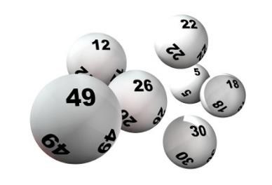
Bootstraping
Repeatedly draw, with replacement, cases until you have a sample the same size as the original data set
(~1/e of original database will be left out)
Do this as many times as you wish
Fit a model to each replicant data set and evaluate those models on the original data
Compare the resulting distribution to the sample statistic of interest (i.e. mean, CV)
premium.wpmudev.org
Notes:
Other sampling techniques: Bootstrapping:
Make inference about a population from sample data
EX: funky herd of cows
Sampling with replacement
Always leaves a hold-out sample of ~37% of the original data
>>>>>>>>>>>>>>>>>>>>>>>>>>>>>>>>>>>>>>>>>>>>>>>>>>>>>>>>>>>>>>>>>>>>>>>>>>>>>>>>>>>>>>>>>>>>>>>>>>>
Narrative:
The basic idea of bootstrapping is that inference about a population from sample data (sample -> population) can be modeled by resampling the sample data and performing inference on these resamples (resample -> sample). As the population is unknown, the true error in a sample statistic against its population value is unknowable. In bootstrap-resamples, the 'population' is in fact the sample, and this is known; hence the quality of inference from resample data -> 'true' sample is measurable.
Uses analogy of a funky herd of cloned cows. Each cow is a little funky but the entire herd is representative of the original cow (dataset). Evaluate the model on the complete original dataset. End up with a histogram of errors.
Central question of model validation: Have I been fooled?
How likely could I have gotten this result or was I just lucky in this case?
Bootstrapping designates a sample data set through sampling with replacement. Sampling with replacement can be thought of as randomly drawing a lottery ball, writing down the number that was drawn, replacing the ball and repeating until a desired sample size has been acquired. Through this method, a different emphasis is present in the sample data than the original population distribution. On average, 1/e (~63%) of the records will be selected in a sample for inclusion in the bootstrap sample. This leaves a 37% hold-out sample (comprised of unsampled numbers) for each bootstrap sample. Basically, this means that a hold-out sample of 37% of the data is always left to assess the model, no matter how many samples one makes!
Image from:
http://premium.wpmudev.org/blog/wordpress-random-post-button-plugin/

Slide 68
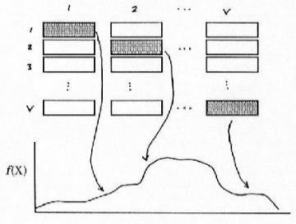
Cross Validation
V-fold Cross Validation
Create v distinct data subsets of v cases through random sampling
Assign a role to each subset
Leave-One-Out Method
V-1 used for training and 1 for testing
Rotate roles so each subset is used for testing one time and training v-1 times
Analyze distribution of test results and accuracy
f(X)
x
Notes:
Other sampling techniques: Cross Validation:
Cross-validation consists of using held-out observations as test data with multiple possible independent observations to hold out
Primarily used to generate a distribution of “out-of-sample” like results
Applicable when there is no available hold-out sample
Helps better train and fit training data
V refers to how many subsets are used for modeling
Procedure:
Create k distinct data subset through random sampling
Assign a role to each subset. K-1 of them will be used for training, 1 for testing (LOO – leave one out method). Begin by assigning subset 1 to testing, and subsets 2 through k for training.
Rotate roles so each subset is used for testing one time and training k-1 times (Sometimes called Rotation Estimation)
More folds -> smaller held-out sample -> more error variance for held-out data
Use in assessing model stability:
Model built of each of the folds (k models)
Errors from testing model with hold-out sample are averaged over the subsets
If accuracy is similar for all folds, the modeling procedure is viewed as being stable and not overfit (average error is an estimate of accuracy)
NOTE: All observations are used for both training and validation, and each observation is used for validation exactly once (advantage over repeated random sub-sampling)
Cross validation enables you to determine empirically the minimum variance to be expected in model performance.
Cross validation results are very useful in comparing the effectiveness of different model types

Slide 69
Data Preparation: Keys
Consider your holdout sample first!
Data preparation cannot be separated from modeling
Consider modeling technique assumptions
Requires visual, statistical, and advanced methods of exploration
Derived features can be critical to a model
Be aware of temporal features of the data
Notes:
As you have learned, the data preparation process is intensive and very involved. It involves a number of specific steps and statistical techniques and can significantly affect model performance and optimization. It should be a process that is ongoing throughout the CRISP-DM process, so it is important to grasp thoroughly.
Fortunately, Data Preparation can be summarized with a number of key points:
Consider your holdout sample first!
As previously stated, the data preparation process begins with separating the complete raw data set into different samples for use when building the model.
Data preparation cannot be separated from modeling
Consider modeling technique assumptions
Additionally, it is important to note that data preparation can be an iterative process that is affected by initial model performance. Therefore, establishing a model goal early is important, because not only does it affect the selection of modeling techniques, but it also impacts data preparation. For instance, certain model techniques may require data to be formatted in a particular way (0 to 1; linear; normalized; etc). Additionally, as with data understanding, background knowledge of data sources and project specific information can help facilitate the formation of project goals.
Requires visual, statistical, and advanced methods of exploration
Advanced exploration methods can give insight into appropriate preparation steps. It can also highlight the need for derived features, which can be critical for optimal model performance. These explorations can also point out temporal features of the data and any associated noise.
Derived features can be critical to a model
Going along with the fact that data preparation cannot be separated from modeling, deriving features can be not only help model optimization, they can be essential for model construction. Careful consideration must be made as to what inputs will be most beneficial for model performance, and the raw variables given must be used to derive these features if possible if they are not already available.
5. Be aware of temporal features of the data
Temporal data can be difficult to include in a model and can impede model performance by introducing a lot of noise. Data Preparation techniques such as filtering and smoothing can help transform time series data into a form that is manageable for analysis tools and able to be reconstructed efficiently with modeling algorithms.

Slide 70
Stage 4
Modeling

Slide 71
DataMining techniques
Statistical analysis:
Using the following tools: 1.ANOVA: o Analysis of Variance, to see whether there are significant differences between the measures of one or more continuous variables in different population groups.
2.Regresión: defines the relationship between one or more variables and a set of predictors of the first.
3.Ji squared tests the hypothesis of independence between variables.Main components: Reduce the number of observed variables to a smaller number of artificial variables, retaining most of the information on the variance of the variables.
4.Análisis cluster: To classify a population in a number of groups, based on profile similarities and dissimilarities between the different components of that population.
Discriminant 5.Análisis: A method of classification of individuals into groups that have previously been established, and find the rule that allows classification of the elements of these groups, and therefore identify the variables that best define the group membership.
Methods based on decision trees:
The method CHAID (Chi Squared Automatic Interaction Detector) is an analysis that generates a decision tree to predict the behavior of a variable from one or more predictor variables, so that the sets of the same branch and the same level are disjoint.It is useful in situations where the objective is to divide a population into different segments based on some decision criterion.
The decision tree is constructed by splitting the dataset into two or more subsets of observations from the values ​​assumed predictors. Each of these subsets back then be partitioned using the same algorithm. This process continues until there are significant differences in the influence of predictive variables of these groups to the value of the response variable.
The root of the tree is the full data set, subsets and subsubconjuntos up tree branches.A set in which a partition is called node.
The number of subsets in a partition can go two to the number of distinct values ​​that can take the variable used for separation. The predictor variable used to create a partition is the one most significantly associated with the response variable under test of independence of the Chi square on a contingency table.
Genetic algorithms:
Are numerical optimization methods, in which variable or variables that are intended to improve along with the study variables are a piece of information.Those configurations of the variables of analysis to obtain best values ​​for the response variable, correspond to the segments with greater reproductive capacity. Through play, the best segments remain and their share grows from generation to generation. It can also introduce random elements for changing the variables (mutations). After a certain number of iterations, the population will consist of good solutions to the optimization problem.
Neural Networks:
Are generally numerical methods in parallel processing, in which the variables interact with linear or nonlinear transformations, to obtain a throughput.These outputs are compared with those who should have gone out, relying on test data, resulting in a feedback process by which the network is reconfigured so as to obtain a suitable model.
Neuronal Network Microstrategy
Fuzzy logic:
It is a generalization of the concept of statistics.Classical statistics is based on probability theory, turn it in joint technical, in which the relation of belonging to a set is dichotomous (the 2 is even or not). If we establish the notion of fuzzy set as one in which the membership has a certain level ("one day to 20 º C is hot?) We will have a broader statistical and so results are closer to human reasoning.
Time Series
Is knowledge of a variable through time, from that knowledge, and under the assumption that no structural changes will occur, to make predictions.Often based on a study of the series in cycles, trends and seasonality, which differ by the scope of time covered, for by obtaining the original series ended. Hybrid approaches can be applied to previous methods, in which the series can be explained not only in terms of time but as a combination of other variables more stable environment and, therefore, more easily predictable.
Classification of data mining techniques
Data mining techniques can be classified as Association, Classification, Clustering and Time Series Predictions.
Association (Association): the relation between an item of a transaction and another item in the same transaction is used to predict patterns.For example, a customer purchases a computer (X) while buying a mouse (Y) by 60% of cases. This pattern occurs in 5.6% of purchases of computers. The association rule in this situation is that "X implies Y, where 60% is the confidence factor and 5.6% the support factor. When the confidence factor and support factor are represented by linguistic variables high and low, the association rule can be written in the form of fuzzy logic, such as "when the support bracket factor is low, X implies Y is high" . This would be a typical example of data mining to study the association between supermarkets selling baby diapers and beer (see blog entry Bifacil).Algorithms used association rules and decision trees.
Model Association in Microstrategy - Buy DVD Movies
Classification (classification) in the standings, the methods they intend to learn different features that classify the data into a predefined set of classes.Given a new predefined classes, a number of attributes and a set of training data or training, methods of classification can automatically predict the class of previously classified data. The more key issues related to the classification are the evaluation of the errors of classification and prediction power. The most used mathematical techniques for classification are binary decision trees, neural networks, linear programming and statistics. Using a binary decision tree, a tree induction model in the form Si-No, we can position the data in different classes depending on the value of its attributes.However, this classification may not be optimal if the power of prediction is low. Using neural networks, one can construct a model of neural induction. In this model, attributes are input layers and classes associated with the data is output layers. Between layers of input and output are a large number of hidden connections that ensure the reliability of the classification (as if they were the connections of a neuron with those around you). The neural induction model gives good results in many analysis data mining, when a large number of relationships complicates the implementation of the method for the large number of attributes.Using linear programming techniques, the classification problem is viewed as a special case of linear programming. Linear programming optimizes the classification of the data, but can lead to complex models that require large computation time. Other statistical methods such as linear regression, discriminant or logistic regression are also popular and frequently used in the classification process .
Decision Tree in Microstrategy
Clustering (Segmentation): The cluster analysis of data without taking group and by using automated techniques makes the grouping of these.The clustering is not supevisado and requires no training data set. Shares a set of methodologies with the classification. That is, many of the mathematical models used in the classification can be also applied to cluster analysis. Using clustering algorithms and clustering sequence.
Prediction (forecasting) / Estimate: prediction analysis is related to regression techniques.The main idea of ​​predictive analysis is to discover the relationships between dependent and independent variables and the relationships between independent variables. For example, if sales is an independent variable, the benefición can be a dependent variable.
Time Series (prognosis): using historical data together with techniques of linear or nonlinear regression, we can produce regression curves were used to make predictions for the future. Algorithms using time series.
Example 1. Analysis basket (Association).
Is a typical example used to explain the field of use of data mining (with the association between the sale of baby diapers and beer).In our case, using the examples provided by MicroStrategy in their platform, learning project, called MicroStrategy Tutorial, we will see an example of using association analysis techniques.
In the example, we analyze the sales of DVD's from a department store and try to find the association between sales of different movies. That is, try to find titles are sold together with the aim of establishing trade promotion then these films (eg, sale of packs, the location of the movies together in the hallways, discount promotion by buying the second unit, etc. ) with the aim of increasing sales.For this type of analysis used analysis of association rules.
Example 2. Customer segmentation (cluster analysis).
With this analysis we analyze our customers and using them demographic information (age, education, number of children, marital status or household type), make market segmentation to prepare the launch of certain products or making promotional offers.
In this case, we will conduct a cluster analysis using the algorithm k-means , which is the supporting Microstrategy.
Example 3.Sales forecast in a campaign (decision tree).
In this analysis using a decision tree to determine the response of a particular group of customers rebates on certain products in the era of back to school. To this end, decision trees use binary (remember that the decision trees can be used both for classification and for regression analysis, as in this case). Try to determine how they influence factors such as age, sex or number of children on the probability of shopping in the sales campaign.
Stage 4
Modeling

Slide 72
Key Components of Modeling
Business Understanding
Data Understanding
Modeling
Evaluation
Deployment
Data Preparation
Modeling
Select Modeling Technique
Generate Test Design
Build Model
Assess Model
Notes:
Modeling is the central iterative process that takes results from the business understanding, data understanding, and data preparation phases as inputs.
The outputs of this phase of the CRISP-DM process include:
Documentation of the modeling technique(s) to be used
Assumptions used to select modeling technique(s)
Plan for training, testing, and evaluating the model(s)
Parameter settings for the selected model(s)
The model(s) themselves,
A description of the model,
An assessment of the model(s) performance
Revised parameter settings
Select Modeling Technique
Modeling Techniques
Modeling Assumptions
Generate Test Design
Build Model
Assess Model

Slide 73
Modeling Techniques: Supervised vs Unsupervised
Analytic Base Table
Supervised Learning
Inputs
Key ID
Target Outcome
Treatments
Covariates
Student ID | Grade | Instructor | Lab Available | Teaching Assistant | Overall GPA | Gender | Prereq. Grade
Sue B. | B | Hall | Y | Turley | 3.5 | F | A
Bryce | A | Smith | N | Ace | 3.2 | M | B
Jean | C | Hall | Y | Mary | 3.0 | M | C
Ann | B | Turner | Y | Mary | 3.8 | F | B
Bob | A | Hall | N | Turley | 3.3 | M | A
Notes:
Do you have a target/ dependent variable?
If you do, and if you have “known cases” or cases for which you “know the answer” then you’ll be doing supervised modeling. Whereas if you don’t have a target variable, or you don’t “know the answer” for any of the line items/rows of your data tables, you will be doing unsupervised modeling.

Slide 74
Modeling Techniques: Supervised vs Unsupervised
Analytic Base Table
Unsupervised Learning
Inputs
Key ID
Target Outcome
Treatments
Covariates
Student ID | Grade | Instructor | Lab Available | Teaching Assistant | Overall GPA | Gender | Prereq. Grade
Sue B. |  | Hall | Y | Turley | 3.5 | F | A
Bryce |  | Smith | N | Ace | 3.2 | M | B
Jean |  | Hall | Y | Mary | 3.0 | M | C
Ann |  | Turner | Y | Mary | 3.8 | F | B
Bob |  | Hall | N | Turley | 3.3 | M | A
Notes:
Do you have a target/ dependent variable?
If you do, and if you have “known cases” or cases for which you “know the answer” then you’ll be doing supervised modeling. Whereas if you don’t have a target variable, or you don’t “know the answer” for any of the line items/rows of your data tables, you will be doing unsupervised modeling.

Slide 75

Modeling Techniques
Supervised
Unsupervised
etc…
Contributory
Consensus
Visual Exploration
Clustering
Principal Component Analysis
Nearest Neighbor
etc…
Kernel
Regression
etc…
Neural Networks
Decision Trees
Use all the tools in your tool belt!
Notes:
As was discussed, your model will either be supervised or unsupervised. Within each category, there are many different implementations. Supervised models can be either consensus-based models, or contributory. In a consensus model, data are used to create a model summarizing its information and then thrown away. Examples of consensus models are Regression, Neural Networks or Decision Trees. When building contributory models, data are retained and potentially employed in the model to evaluate a new case. This is done in nearest neighbor and kernel modeling.
Unsupervised modeling may already be complete if you did a bit of visual exploration outlier detection or PCA during the phases of Data Understanding or Data Preparation.
There is an expression that, to a little boy with a hammer, all the world is a nail. When modeling, however, we don’t want to be so narrowly focused. These are just a few of the tools you have at your disposal. Be sure to explore different options of how to model your data.
Image: www.vectorart.com

Slide 76

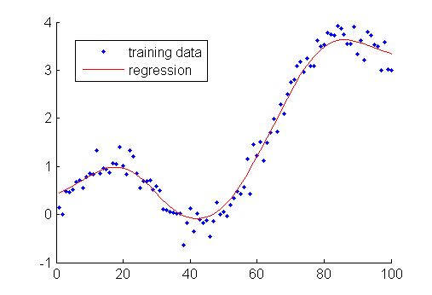
Modeling Techniques: Regression
Estimates relationship between one or more predictor variables and a target variable
Useful for prediction and feature selection
Types include:
Simple Linear
Multiple Linear
Nonlinear
Logistic
Exponential
Polynomial
Notes:
Regression algorithms estimate relationships between one or more predictor, or input variables and a target variable. The target variable can be continuous (linear regression) or binary (logistic). There are many different types of regression algorithms which can be useful for prediction and feature selection.
A simple linear regression model can have quadratic and geometric terms, but it is still an linear regression. One multiplicative coefficient is being estimated per term.

Slide 77
Modeling Techniques: Regression
Stepwise Regression:
Choose the single best term. Add the term that best combines with it, and then add the one that best combines with the pair. (Check also whether any current term should be discarded).
Results in Y = f(a) rather than exact model Y = b + c.
(Polynomial network algorithms, however, can work on this example.)
Y | a | b | c
1 | 1 | 0 | 1
1 | 1 | 0 | 1
1 | 1 | 1 | 0
1 | 0 | 1 | 0
Notes:
While contributory models need to be prepared for by reducing dimensionality of your data, Regression has a built-in way of handling many variables: Growing Regression Models.
Stepwise regression adds or removes one term at a time to see what terms are most useful in creating an effective estimator.
The example shown in this table has a target variable, Y and three input variables, a, b, and c. Consider a regular regression procedure performed with this data set. The resulting equation may look like: Y = 0a+ 1b+1c. However, if we ran a stepwise algorithm on the same dataset, the result would simply be Y = a since it will capture most of the variance in the target variable.

Slide 78


Modeling Techniques: Regression
Strengths
Efficient analysis that is useful for prediction
Easy to interpret
Can take many predictor variables
Generalizes well (low variance)
Weaknesses
Assumptions about variables constrain analysis
Evaluating models becomes more difficult with complexity of model
Sensitive to outliers and, like most models, should not extrapolate
High bias
Bottom line: Interpretable and useful for prediction, but must check assumptions
Notes:
Regression techniques provide efficient analysis that is useful for predicting targets. Models are usually easy to interpret since we can see the coefficients for each input variable. Regression techniques can take in many predictor variables. Still, there are some weaknesses to regression modeling, and since it is such a well-known tool, we need to defend against over-use or misuse. Regression requires that we abide by several assumptions about input variables. Evaluating the model can become very complex in high dimensions. This is because the shape of the response curve is necessary to choose the best model, that curve is hard to visualize at high dimensions. Regression is sensitive to outliers, and like most models, we should be wary to extrapolate.
Source: http://n-steps.tetratech-ffx.com/PDF&otherFiles/stat_anal_tools/regression_final.pdf

Slide 79
Modeling Techniques: Bootstrapping/Bagging
Create K bootstrap replicates of the data set.
Fit a model to each of the replicates.
Data
Sample 1
Model 1
Result 1
Sample 2
Model 2
Result 2
…
…
…
Sample K
Model K
Result K
Breiman, 1996
Notes:
The term bagging is a combination of Bootstrap Aggregating.
We begin the bagging process by taking a bootstrap sample, which is just sampling (K) times with replacement. This means that each of our K samples may include data that is in the other sample(s). We then fit a model to each of these sample data sets. We will have (K) models. Running the models will give us, then, k results

Slide 80
Modeling Techniques: Bootstrapping/Bagging
Create K bootstrap replicates of the data set.
Fit a model to each of the replicates.
Average (or vote) the predictions of the K models.
Result 1
average
Result 2
…
Result K
Final Result
Breiman, 1996
Notes:
The final step of Bagging is averaging the predictions of the models. If we’re doing a classification problem, then the final result will be a majority vote of the classification results of the K models. If it’s a regression, or otherwise continuous prediction algorithm, the final result will be an average of each of the K results.
Bagging improves accuracy by decreasing overall variance of the model. It is great for unstable classifiers like CART, that may change significantly with small changes in the data set.
Bootstrapping simulates the stream of infinite data sets in a bias-variance decomposition. –Breiman 1996
For more information see: Breiman, Leo, Bagging Predictors. University of California at Berkley, Department of Statistics Technical Report No. 421, 1994
http://statistics.berkeley.edu/sites/default/files/tech-reports/421.pdf

Slide 81


Build Model: Model Description
variables included
algorithms considered
& used
results
challenges
interpretation
model settings and options
Notes:
Add your model descriptions into your project document or elsewhere
Like the project document, this is a living documentation of your ongoing work
Return to your records from Business Understanding and recall what your data mining goals and requirements are. Cross-check your proposed modeling techniques.
Return to Data Preparation: Is your data in the correct format for the models you are considering to use? You may need to return and reformat data
Missing values
Categorical variables

Slide 82
Model Assessment
Technical
&
Statistical
Measures
Goodness of fit
Lift
Accuracy
Business
Measures
Workload
Notes:
During the model assessment part of the modeling process, we will compare our model using measurements established in our test design. This is to address the Technical and Statistical success of our model. We will address the Business Measures in the next Phase
Now assess the model using them. We may need to adjust the model’s options according to how well the fit is for our validation and test data.
What is the stopping point? ← slide from john
Measurements assessing: lift, goodness-of-fit, residual statistics
some reward for complexity and some punish for complexity
For more information see: An Introduction to Statistical Learning: With Applications in R - by Gareth James, Trevor Hastie, Robert Tibshirani, Daniela Witten

Slide 83
Stage 5
Evaluation

Slide 84
Key Components of Evaluation
Business Understanding
Data Understanding
Modeling
Evaluation
Deployment
Data Preparation
Evaluation
Evaluate Results
Review Process
Determine Next Steps
Notes:
The Evaluation phase is an assessment of data mining results with respect to business success criteria. This may also produce ideas or hypothesis for future data mining projects.
During the evaluation phase, we will review the entire CRISP-DM process up to this point in order to identify any factors that may have been overlooked. Then we will make a list of possible actions which can be pursued through further iterations of CRISP-DM or project deployment.
Evaluate Results
Assessment of Data Mining Results
Approved Models
Review Process
Determine Next Steps

Slide 85
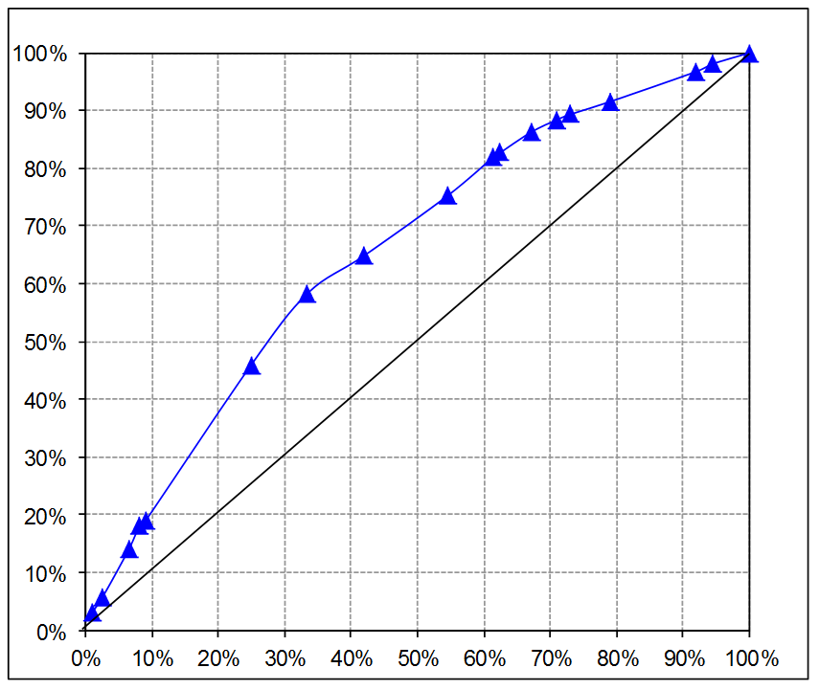
Model Assessment: Cumulative % Captured Response Chart & Confusion Matrix
2a. Or, set desired response
1b. Note expected response
Decision tree splits
1a. Set investigation limit
2b. Note work requirements
Notes:
Finding the right threshold or cutoff value to use when model is implemented is important and can require significant effort. Here is a list of possibilities:
The organization is constrained to work a certain percentage of the cases. This is the most straightforward case. From the Cumulative % Response chart, read the expected response, or hit rate.
The organization needs to capture a certain percentage of the responses or hits. Read the chart in the opposite direction.
Minimize costs, given the model. This is usually the most rational answer but requires more analytic effort.
For each of the cells in the relevant truth table, identify the cost (or value) associated with each cell for an observation that falls within that cell. In most cases, there will be only two non-zero values.
Calculate the truth table for several points along the chart.
Multiply the cost for each cell by the number of observations in each cell, and compute total cost.
Select the truth table, hence the cutoff value, with the minimum cost.
Note that now the model assessment metric becomes more clear: Select the model that performs best at the chosen threshold, or cutoff value.
The triangles of the gain chart show where the leaf node changes in the decision trees. Between triangles, all entities have the same probability (on the same leaf node).

Slide 86
Assess Data Mining Results
Design the criteria of merit based on the need of the problem.
Fraud Detection Modeling
Business Goal: Increase detection while reducing resources!
Increase detection → minimize misclassification (false positives)
How many cases do you plan to investigate?
 |  | Actual
 |  | OK | Fraud
Predicted | OK | 800,000 | 100
 | Fraud | 20,000 | 900
workload
...
Notes:
In the Business Understanding workshop, we discussed criteria of merit. This is what you will use as you generate a test design.
This graph is called a confusion matrix, contingency table, truth table, or error matrix. It is showing the results of a supervised model to predict fraud. Across the top of this matrix you see the actuals and on the left side you see the predictions from the model.
All scoring systems are trading detection (hits) against workload (predicted positives). All systems have thresholds that can be adjusted to optimize this trade-off for a particular solution. The workload in this case is the investigations which are spawned by predicting that cases are fraudulent.
Even though the model considered here is 97% accurate at predicting non-fraud, there are so many more non-fraud instances in the population, that we have to look into 23 cases to find one bad one.
So, our success criteria may be a smaller overall workload- less cases predicted as fraud, depending on the cost of investigation
Images: Nisbet, Elder & Miner, Statistical Analysis and Data Mining (p308)

Slide 87
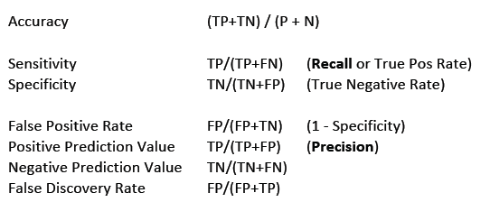
Assess Data Mining Results: Confusion Matrix
 |  | Actual
 |  | Positive | Negative
Predicted | Positive | True Positives (TP) | False Positives (FP) Type I Error
 | Negative | False Negatives (FN) Type II Error | True Negatives (TN)

Slide 88
Model Assessment: Medical Confusion Matrix
 | Actual No | Actual Yes | Total
Predicted No
Predicted Yes
Total
67,701 true negatives
15,167 False Negatives
82,868
3,853 False Positives
10,762 true positives
14,615
71,554
25,929
97,483
Baseline (Say “No” every time) = 71,554 / 97,483 = 73.4%
Accuracy = (67,701+10,762) / 97,483 = 80.5%
Δ over Baseline = 80.5% - 73.4% = 7.1%
...
Notes:
This graph is called a confusion matrix, contingency table, truth table, or error matrix. Confusion matrices show results for a supervised model, where we know what the true positives are. Across the top of this matrix you see the actuals (from the known cases, since this is a supervised model) actual no and actual yes, then along the left are the predictions: predicted no and yes.
As a baseline, with no predictive inputs, one would choose the most common result, No, and would be correct 73.4% of the time (at the bottom of the matrix), and incorrect 26.6% of the time (calculated from totals).
This predictive model, however, (with a particular threshold) is correct 80.5% of the time, 7.1% better accuracy than the baseline case.
Consider: What is the cost of 15,167 false negatives? Of 3,853 False Positives? The answers can come from subject matter experts.
The cost of a false negative versus that of a false positive will determine where you put your cutoff for predictive modeling. For instance, in detecting fraudulent cases, a false negative means that we don’t flag a potentially case and then it turns out to be fraudulent. This is going to depend on the costliness of the case. Alternatively, a false positive means that we flag a case that isn’t fraudulent. That is going to cost us the investigation (or other follow up protocol) for that case even though we will not find anything. The question, then is what is more costly? Missing the fraudulent case or investigating a non-fraudulent case. Other factors will likely come into play here, such as, how expensive is an investigation? How much fraud (in $) is this case worth?
The sum of the cost of all the false negatives and positives is the total cost of a particular model. We will discuss how to set a threshold or cut-off value in order to minimized the total cost.

Slide 89
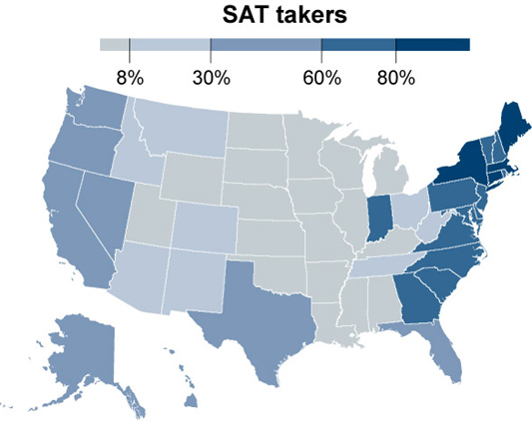
Assessment of Data Mining Results: Data Visualization
economix.blogs.nytimes.com
Notes:
Example of SAT average test score results
It appears that spending is negatively correlated with SAT scores, but in fact, the data did not account for the different density of students who took the test. In some states, in-state schools only required the ACT test scores and not the SAT. Therefore only students planning to leave state for college took the SAT.
If data scientists had considered this visualization of their data, they may have discovered the phenomenon
SAT Math and Writing scores show a similar geographic patterns
Image and article on this phenomenon:
http://economix.blogs.nytimes.com/2009/08/28/why-the-midwest-rules-on-the-sat/?_php=true&_type=blogs&_r=0

Slide 90
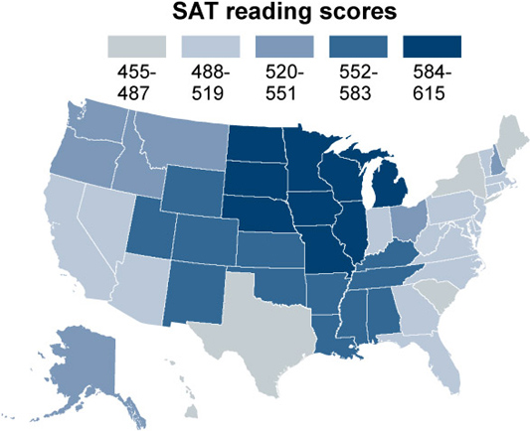
Assessment of Data Mining Results: Data Visualization
economix.blogs.nytimes.com
Notes:
Example of SAT average test score results
It appears that spending is negatively correlated with SAT scores, but in fact, the data did not account for the different density of students who took the test. In some states, in-state schools only required the ACT test scores and not the SAT. Therefore only students planning to leave state for college took the SAT.
If data scientists had considered this visualization of their data, they may have discovered the phenomenon
SAT Math and Writing scores show a similar geographic patterns
Image and article on this phenomenon:
http://economix.blogs.nytimes.com/2009/08/28/why-the-midwest-rules-on-the-sat/?_php=true&_type=blogs&_r=0

Slide 91
Review Process: Ways Predictive Models Fail in Production
Problem | Examples | Remedies
Leaks from the future | Inputs include items that are impossible to know at the time the business would actually run the model. | Disciplined scrutiny + KDD approach
Overfit | Too many inputs Too many methods attempted Random chance Multi-collinearity in regression models | Hold out sample; get more data; resampling; target reshuffling
Seasonal changes | December sales different from January More Monday calls than Wednesday | Data should span all seasons
Real changes | SARS; 9/11; Recession; regime change | Out-of-time sample; model monitoring
Notes:
Model failures are costly. Leaders and analysts might initially be very excited about the forecasted performance of a new model. But if they find that the predictions from the model are very wrong when put into use, this can be very discouraging and costly to the organization, causing it to abandon hopes for predictive analytics.
Leaks from future
Inputs include items that cannot be known at the time the business would actually run the model. This is a common model building mistake. Give-away is whenever model is nearly or absolutely perfect, though evidence of this problem can be more subtle.
Careful and thoughtful compilation of the data is required. Disciplined scrutiny of all the inputs, by peers or others in the organization, is essential.
Overfit
Too many inputs: Some input variables’ significance is coincidental, such that a different sample would show no significance. Too many methods attempted: Try enough methods and one will work, but only by random coincidental chance! The results are not reproducible. Chance that random sample is not representative of the relevant population: Observational data shows random relationships because the random sample is not representative of population.
Multi-colinearity in regression models causes them to work only on training data. (Muli-colinearity happens when two or more inputs are highly correlated. Hence all but one of them should be dropped as an input.)
Actions to consider: Hold out sample; Get more data;
Resampling; Target reshuffling; Reduced number of inputs.
Seasonal changes
This is a special case of training data not being representative of the relevant population. If a model is trained only on December data, don’t expect it to apply well to January! Monday’s call volume is nothing like Wednesday’s.
Data should span all seasons when possible.
Real changes
World (or local) events can change behaviors and change cause-and-effect relationships. Think about these:
SARS or other new epidemic 9/11 Recession Introduction of the Internet to the masses Regime change in a national government
Climate change
But the changes can be more local or specific to your organization or the industry, such as a change in laws regarding insurance or credit, or as simple as a release of a new version of a product.
If at all possible, every model should be tested on a data sample that post-dates all of the training data. Also, recognize from the start that models should be monitored regularly, so they can be updated in a timely fashion before they reach obsolescence.
Treatment changes
When a new action is taken based on a model’s prediction, that action might actually change behaviors in the opposite way. For example, an analysis may show that the most likely time to contact customers is at 6 pm. Call center resources might be alaigned to take advantage of this fact. It works, initially, but then customer behavior changes to not answer calls at this hour.
Likewise, a broad announcement of a forecasted increase in the price of a particular stock might itself change the price of the stock, contrary to the forecast.
Every modeler should think about the impact of actions that might be taken as a result of communicating a prediction of any kind.

Slide 92
Review Process: Test Many Times
V-Fold Cross Validation aka Rotation Estimation
Split data into V different data subsets
Train models on all but one subset (V-1)
Test each on the unseen data- the Vth subset
Analyze distribution of test results
Subset 1
Model 1
Subset 2
Train model
Model 2
Test model
…
…
Subset V-1
Model V-1
Subset V
Result 1
Result 2
…
Result V-1
Notes:
Toy example is illustrated in this slide. You would not do this for only 5 subsets!
Primarily used to generate a distribution of “out-of-sample” like results
No available hold-out sample
Help better train and fit training data
Combines measures of fit/error, each from random, non-overlapping subsets (“unseen”)
Partitions are explicit – results repeatable
LOO (Leave One Out) Method – for small data sets you may need to set V=N, for example. If there are 10 samples in your whole dataset, you may want to make N-1 or 9 experiment subsets, each with only one of the samples left out. The final, 10th experiment subset will be your test dataset.
The difference between this and Bootstrapping is that bootstrapping involves replacement, so you may include a sample in any of your training or test set twice. Cross Validation requires that each sample be non-overlapping, so each line item or data point is going to be assessed only once.

Slide 93
Stage 6
Deployment
Notes:
NOTES:
Deployment = using predictive models for predicting data in the real world!
>>>>>>
Narrative:
The process of using predictive models for predicting data that were not used in training the model is the final stage of the CRISP-DM process and is known as deployment.

Slide 94
Deployment Principles
Model Building
A series of experiments yielding a fit model
Analytic Base Table (ABT)
Preparation
&
Modeling
Fit Model
Data
$$\hat{y}=β_{0}+β_{1}x_{1}+β_{2}x_{2}+…+β_{n}x_{n}$$
$$β_{0}=−2{ ; β}_{1}=4 ; β_{2}=6$$
$$\hat{y}=−2+4x_{1}+6x_{2}$$
Notes:
What is deployment?

Slide 95
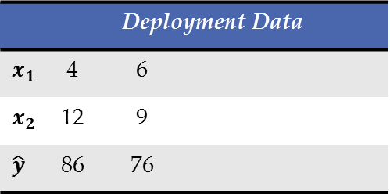
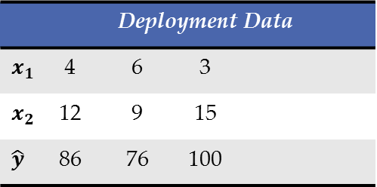
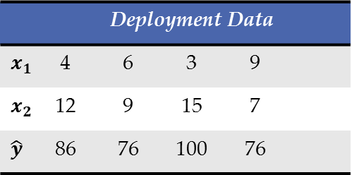
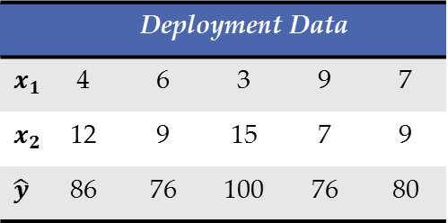

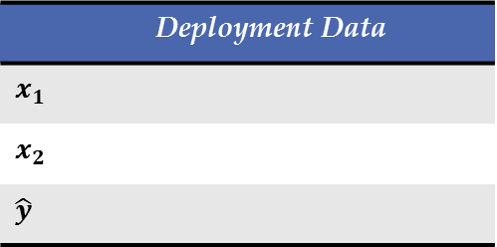





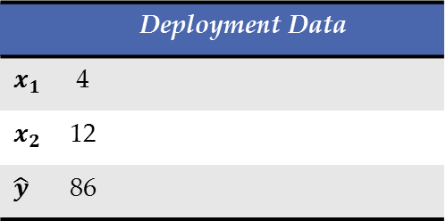
Deployment Principles
Model Deployment
Consistent scoring of a model (manually, semi-automatically, automatically) in a production environment
Preparation
&
Scoring
Deliver Results
New
Data
 | Deployment Data
 | Deployment Data
 | 4
 | 12
 | 86
 | Deployment Data
 | 4 | 6
 | 12 | 9
 | 86 | 76
 | Deployment Data
 | 4 | 6 | 3
 | 12 | 9 | 15
 | 86 | 76 | 100
 | Deployment Data
 | 4 | 6 | 3 | 9
 | 12 | 9 | 15 | 7
 | 86 | 76 | 100 | 76
 | Deployment Data
 | 4 | 6 | 3 | 9 | 7
 | 12 | 9 | 15 | 7 | 9
 | 86 | 76 | 100 | 76 | 80
$$\hat{y}=−2+\left(4×3\right)+\left(6×15\right)$$
$$\hat{y}=−2+\left(4×9\right)+\left(6×7\right)$$
$$\hat{y}=−2+\left(4×7\right)+\left(6×9\right)$$
$$\hat{y}=−2+\left(4×4\right)+\left(6×12\right)$$
$$\hat{y}=−2+\left(4×6\right)+\left(6×9\right)$$
$$\hat{y}=−2+4x_{1}+6x_{2}$$
Notes:
What is deployment?

Slide 96
Plan Deployment
New Collected Data
Training Data
Data Mining and Model Generation
Compute Best Prediction from all Models
Connect New Data Here
Results
Analytics Tools and
Best Models Generated
Potential processes for collecting and working with new data:
Access data directly and extract just enough to create and display results
Data remains in database during analysis
Notes:
NOTES:
Sending a solution to the customer:
Preferred solution = delivering a user-interface or tool that is not able to be manipulated
Prevents accidental changes
Black box solution
Gather and load new data
Click button to analyze data, generate best models and then compute best prediction from models
Results output or easily retrieved with scores
>>>>>>
Narrative:
After training and developing a model, or a set of best models, a deployed solution can be sent to the customer. Removing or embedding any training information and simply passing on a user-interface for the end user is often preferred as it can eliminate confusion and can prevent accidental parameter modification or model adjustment. This interface can be customized further by only giving the user a single node that will Compute the Best Prediction from all Models. This can even be renamed “Connect New Data Here” so that all the customer would have to do is gather data, load it into the modeling tool, click a button and retrieve results and scores!
****************************************************************************

Slide 97
Key Components of Deployment
Business Understanding
Data Understanding
Modeling
Evaluation
Deployment
Data Preparation
Deployment
Plan Deployment
Plan Monitoring and Maintenance
Produce Final Report
Review Project
Notes:
NOTES:
Deployment can look different on a case-by-case basis
More of an art than a science
Includes four main components:
Planning deployment
Planning monitoring and maintenance
Producing a final report
Reviewing the project
>>>>>>
Narrative:
Deployment is more of an art than it is a science. Deployment has four key components that include planning the actual deployment process, planning monitoring and maintenance, producing a final report and reviewing the project as a whole.
Create deployment plan
Model monitoring plan
Model maintenance plan
3. Produce final written report
Produce final modeling presentation
4. Review project

Slide 98
Deployment
Deployment
Model & Results
Evaluation & Interpretation Strategies
Model & results use monitoring
Methods for measuring benefits
Potential problems
Alternative deployment plans
Model Creation Procedures
Data Analysis & Preparation Procedures
Business Goals
Data Mining Techniques
Model Implementation
Notes:
NOTES:
Deployment plans incorporate:
Data mining analyses / techniques / results
Model implementation guidelines
Project business goals
Helps insure model is utilized to full potential and return on investment is reached
Accomplished by including ideas about how to pass knowledge and information to users in understandable formats
Deployment plan components:
Describes procedures:
Data mining and analysis
Model creation procedures
Evaluation and interpretation strategies and procedures (how they relate to business objectives)
Steps for monitoring model and results
Methods for measuring / tracking benefits
Record of potential problems to lookout for and alternative deployment plans if problems are significant
>>>>>>
Narrative:
In order to make sure deployment is effective and models are utilized to their full potential, plans really take into account the business goals of the project. The strategies developed in the plan focus on using and implementing the data mining results and predictive capabilities of the model into the customer’s business. Therefore, plans will incorporate ideas for effectively passing knowledge and information to users in understandable formats. This includes planning for how the tools, model and results will be deployed within the customer organization’s hierarchy and system.
As previously stated, the plan should thoroughly describe the procedures used to create the relevant model (which includes all of the data analysis procedures that were critical in model formation, as well as evaluation/interpretation strategies). The plan will also include steps for both interpreting and deploying results from future data mining tasks and model implementation.
Finally, the deployment plan will include plans for monitoring the use of the model and its results within the customer’s business and keeping track of measuring the benefits achieved through the use of the new data mining practices. Any potential problems or road-blocks identified in model preparation should also be noted in the Deployment Plan so that users will be on the lookout for them and have strategies on-hand for troubleshooting or fixing the problems. Alternatively, if problems are significant, the deployment plan may include alternative plans for deployment.

